Slide 1
MLOps
Università di Modena e Reggio Emilia
Prof. Nicola Bicocchi (nicola.bicocchi@unimore.it)

Slide 2
Motivation for MLOps

Slide 3
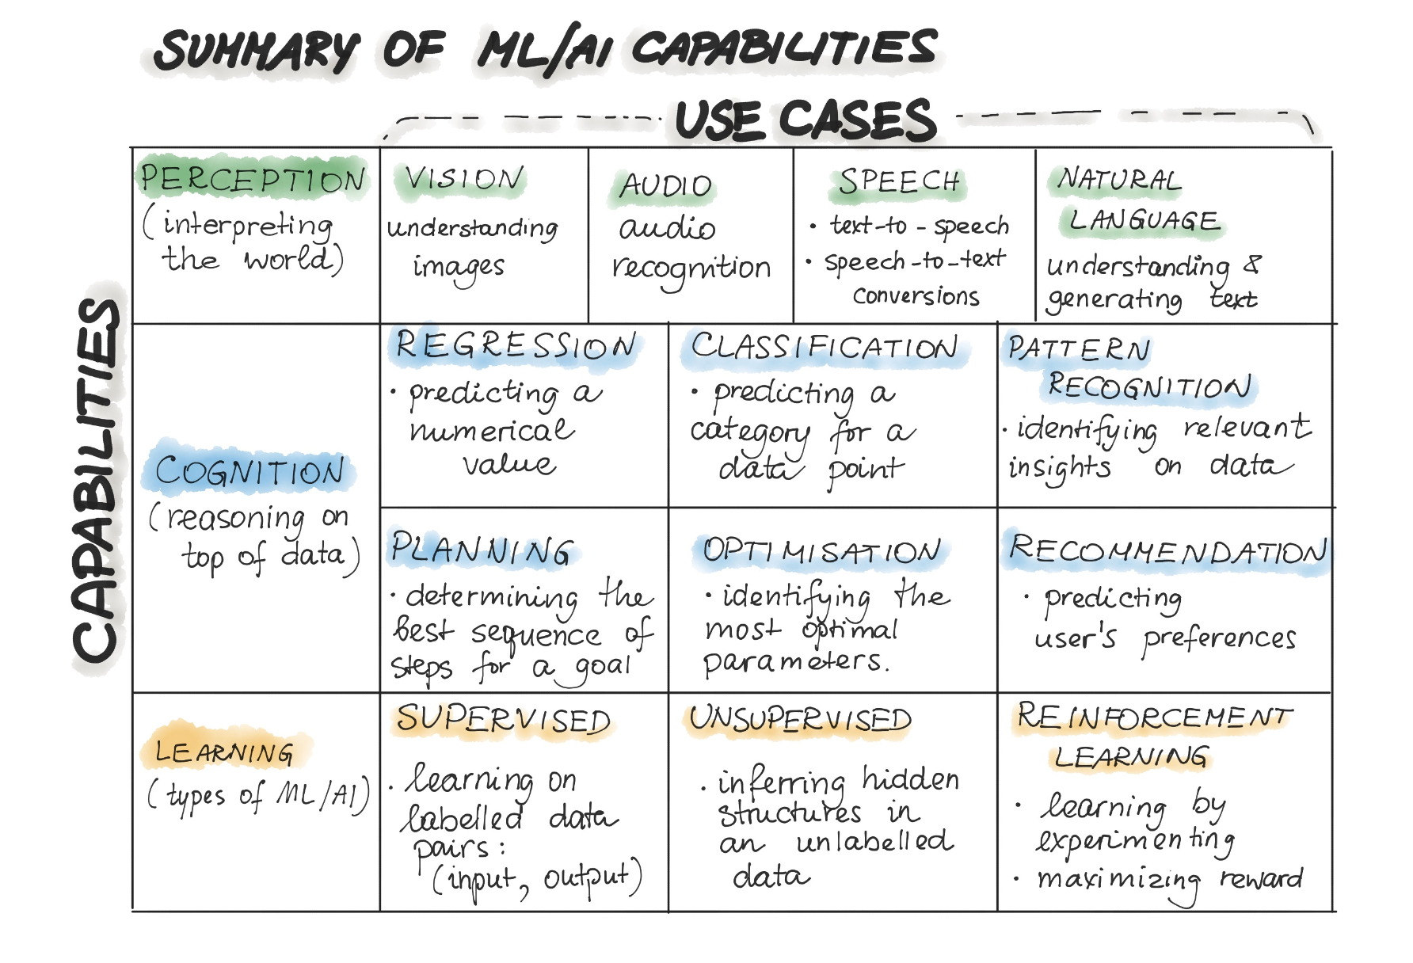
ML/AI Capabilities

Slide 4
State of Enterprise ML/AI
“One magical aspect of software is that it just keeps working. If you code a calculator app, it will still correctly add and multiply numbers a month, a year, or 10 years later. The fact that the marginal cost of software approaches zero has been a bedrock of the software industry’s business model since the 1980s.
This is no longer the case when you are deploying machine learning (ML) models. Making this faulty assumption is the most common mistake of companies taking their first artificial intelligence (AI) products to market. The moment you put a model in production, it starts degrading.”
Forbes - Why Machine Learning Models Crash And Burn In Production
“…developing and deploying ML systems is relatively fast and cheap, but maintaining them over time is difficult and expensive.”
D. Sculley et al., “Hidden Technical Debt in Machine Learning Systems, NIPS 2015
“The hardest part of machine learning today is deploying and maintaining accurate models, as it requires constant access to new data to update them and improve their accuracy.”
Chris Pouliot, Head of Data Science, NIO
“About 20 percent of companies that use machine learning have successfully deployed an ML model into production […] The main challenges people face when developing ML capabilities are scale, version control, model reproducibility, and aligning stakeholders”
2020 State of Enterprise Machine Learning

Slide 5

State of Enterprise ML/AI

Slide 6
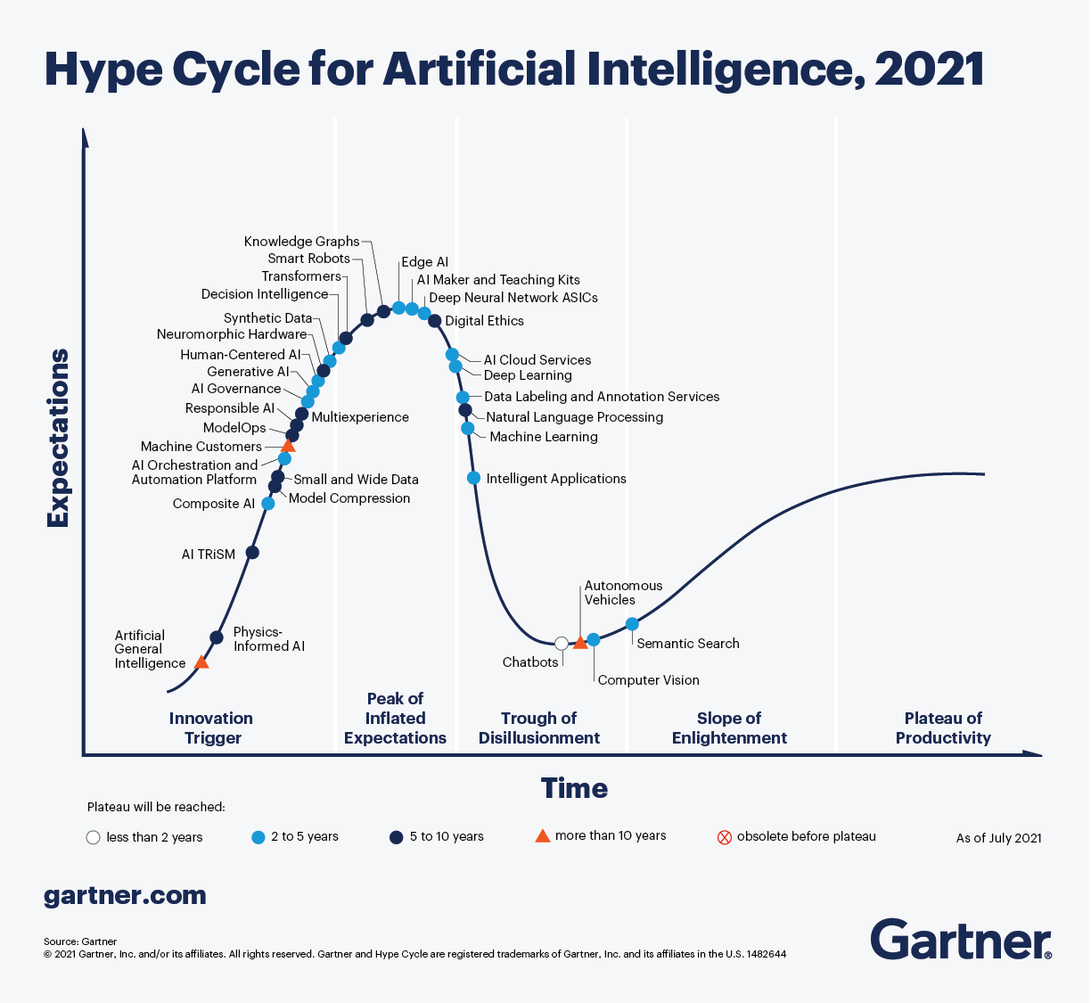

MLOps

Slide 7
Data and Code are behind a model
The reason for the previously described deployment gap is that the development of the machine learning-based applications is fundamentally different from the development of the traditional software.
Traditional software codifies actions as explicit rules.
ML does not codify explicitly. Instead, rules are indirectly set by capturing patterns from data. This makes ML more suitable for a more focused type of problem that can be treated numerically. For example, predicting salary from experience, education, location etc.

Slide 8
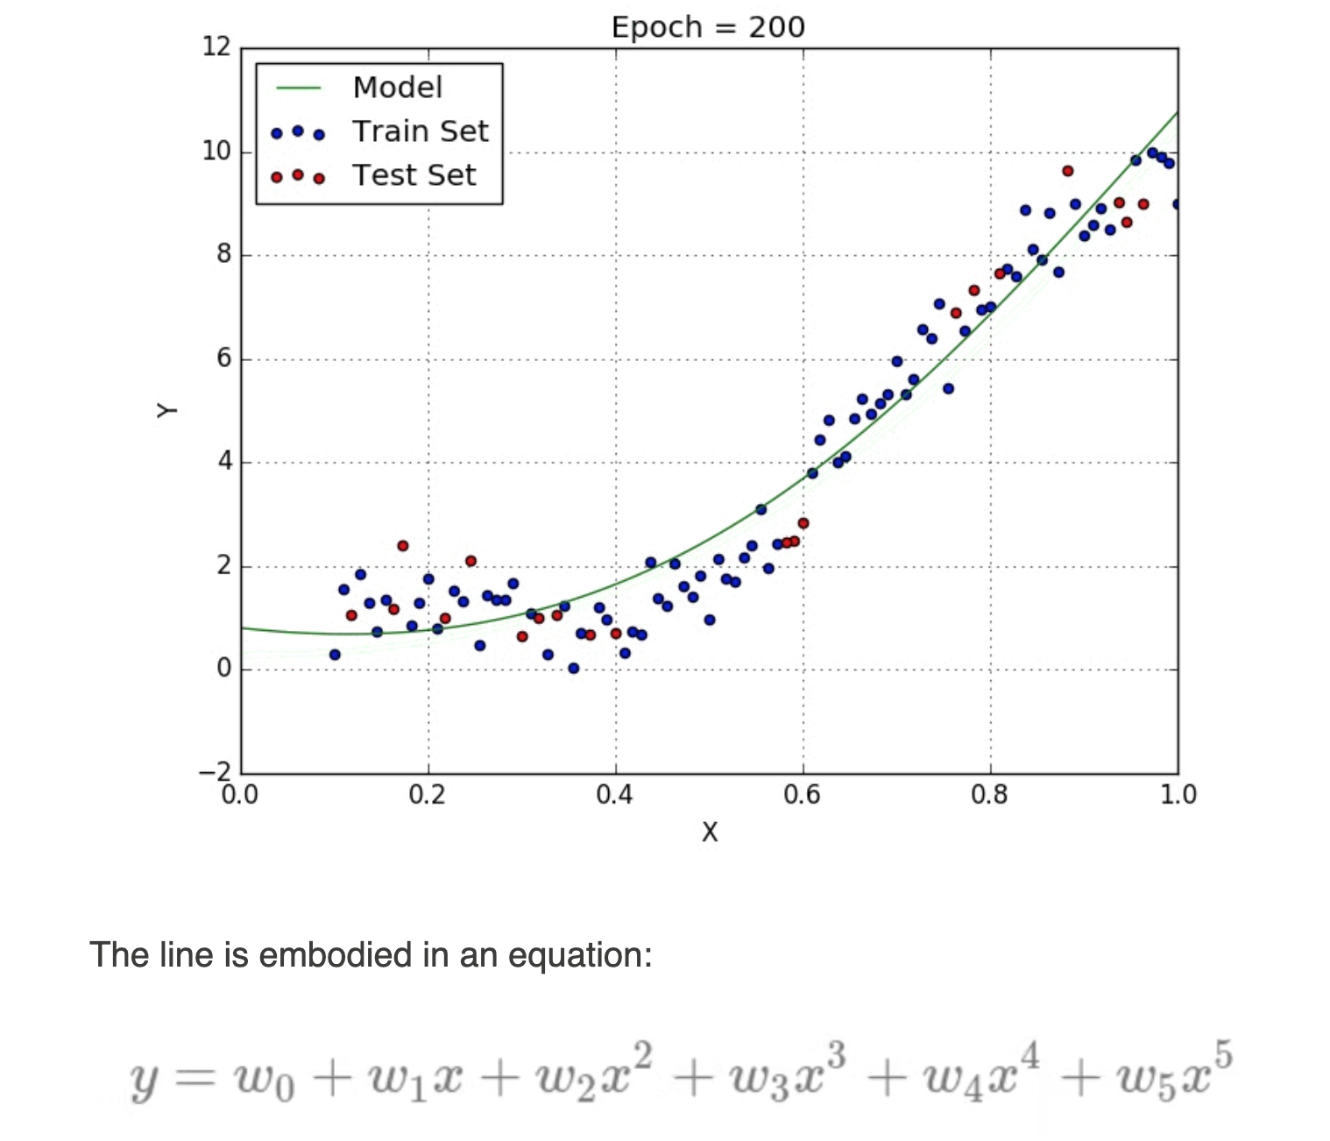
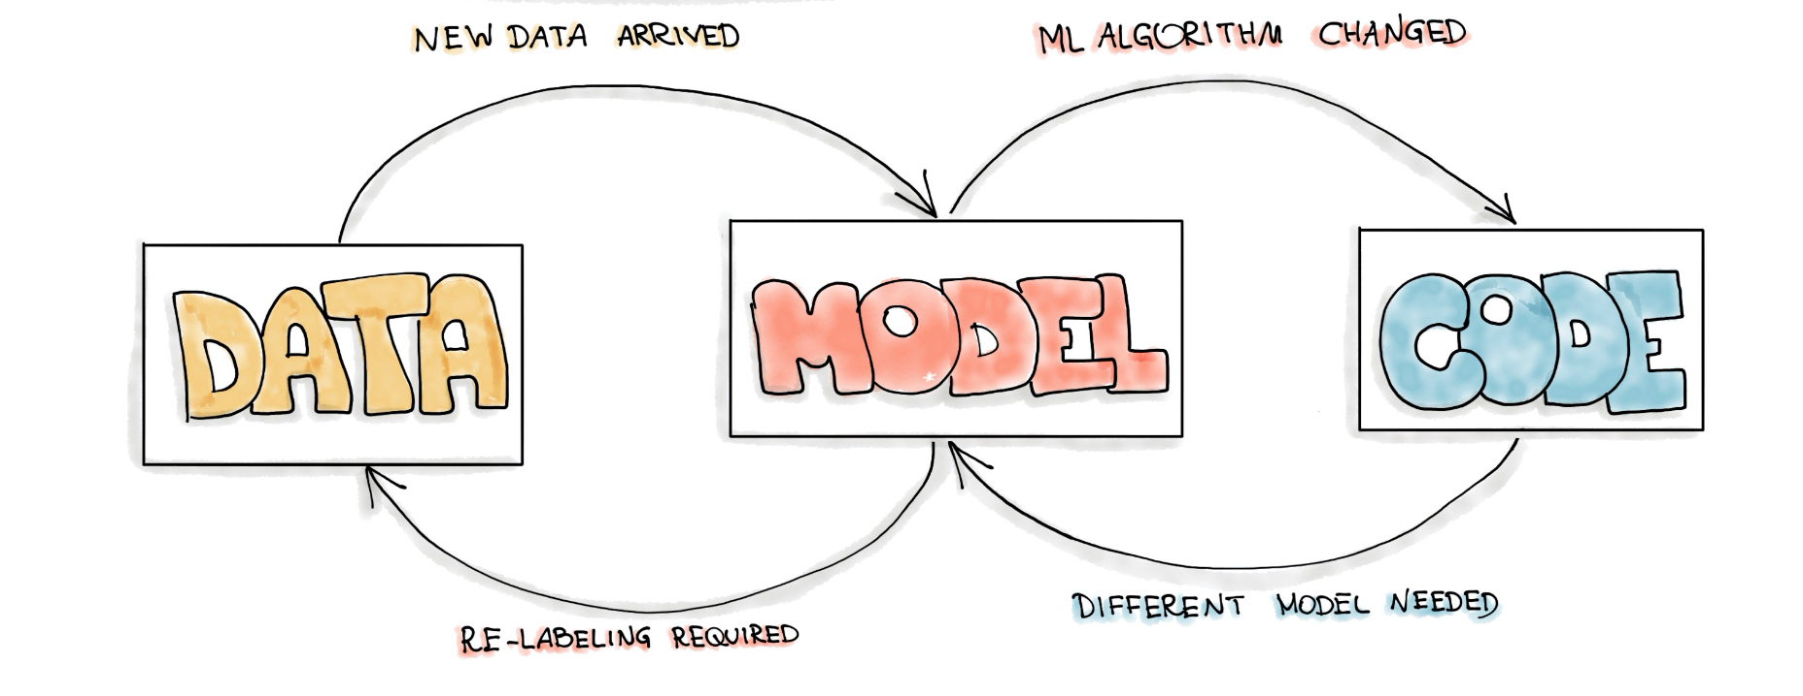

Data and Code are behind a model
The complete development pipeline includes three change levels: Data, Model, and Code.
In machine learning-based systems, the trigger for a build (or any other automated activity) might be the combination of a code change, data change, or model change. (see Technical Debt paper)

Slide 9
What can happen?
After serving the model to the end-users, we might recognize that the assumptions we made for training the model are wrong, so we have to change our model.
We might go back in the process and either collect more data, or collect different data and re-label training data. This should trigger the re-training of the ML Model.
After deploying the ML model into a software system, the model might start to decay and behave abnormally, so we would need new data to re-train our ML model.
Sometimes the business objective might change while project development and we decide to change the machine learning algorithm to train the model.
When transferring ML models to new business customers, these models, which have been pre-trained on different user demographics, might not work correctly according to quality metrics

Slide 10
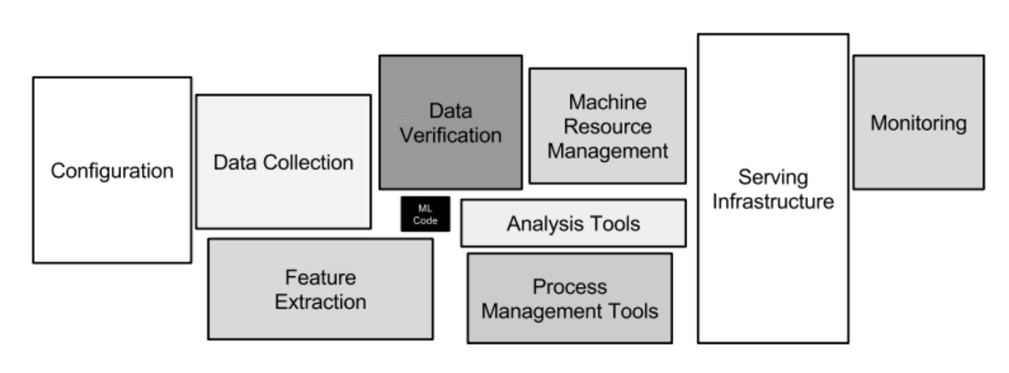
MLOps

Slide 11
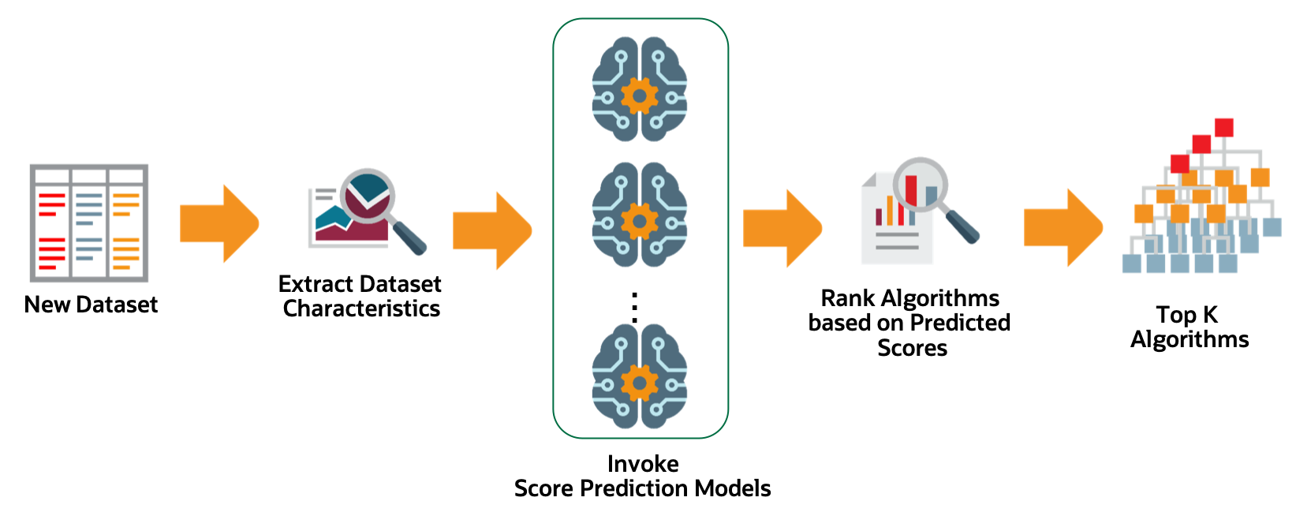
AutoML
Automatic selection of model type
Automatic feature selection and engineering
Automatic tuning of hyper-parameters
Improve efficiency by automatically running repetitive tasks. Automated ML pipelines also help avoid potential errors caused by manual work (e.g., PyCaret, Auto-SKLearn, MLBox, TPOT)
Still active research

Slide 12
MLOps
“The extension of the DevOps methodology to include Machine Learning and Data Science assets as first-class citizens within the DevOps ecology” (https://github.com/cdfoundation/sig-mlops)
“The use of scientific principles, tools, and techniques of machine learning and traditional software engineering to design and build complex computing systems. Machine Learning Engineering encompasses all stages from data collection, to model building, to make the model available for use by the product or the consumers”

Slide 13
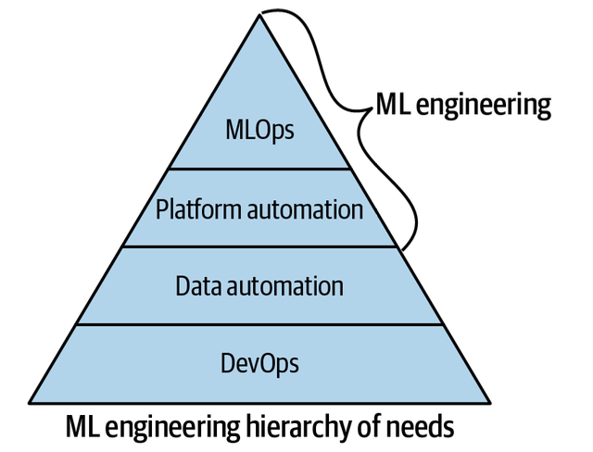
MLOps
MLOps shares a lineage with DevOps in that DevOps philosophically demands automation.
A common expression is if it is not automated, it’s broken.
Similarly, with MLOps, there must not be components of the system that have humans as the levers of the machine.
MLOps can be seen as the process of automating machine learning using DevOps methodologies.

Slide 14
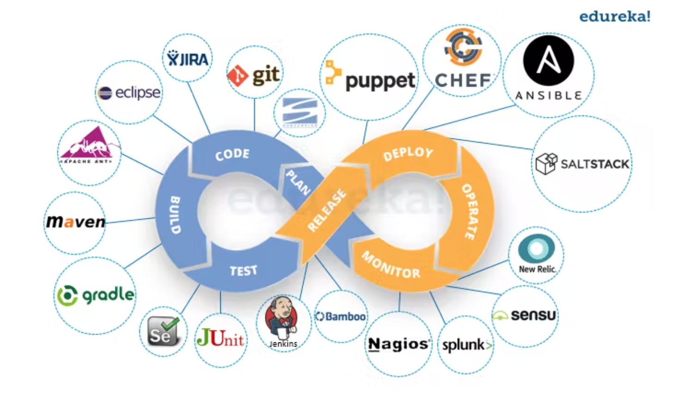
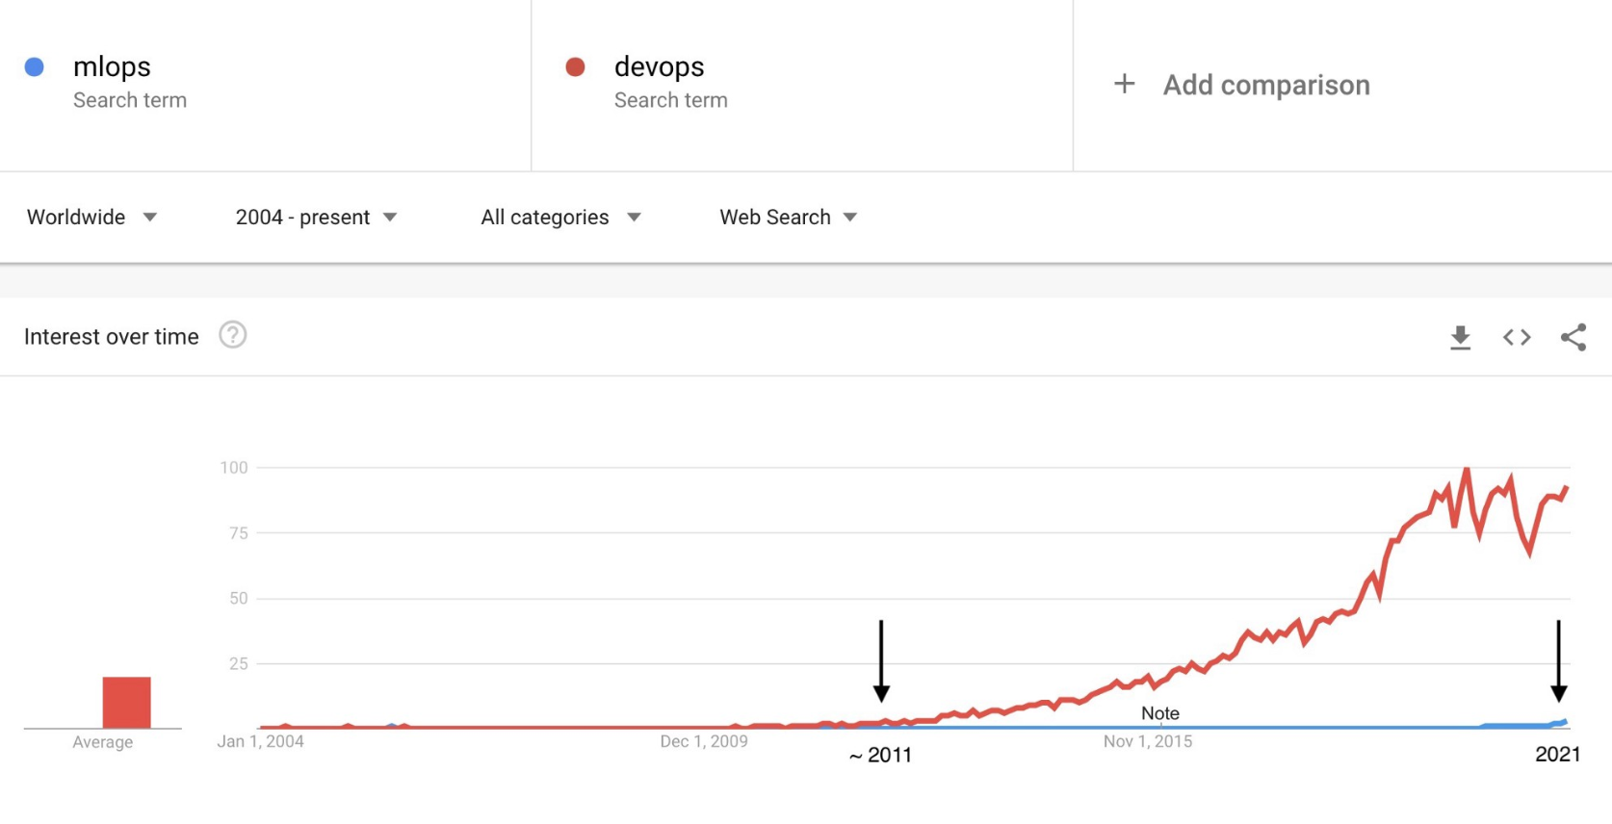
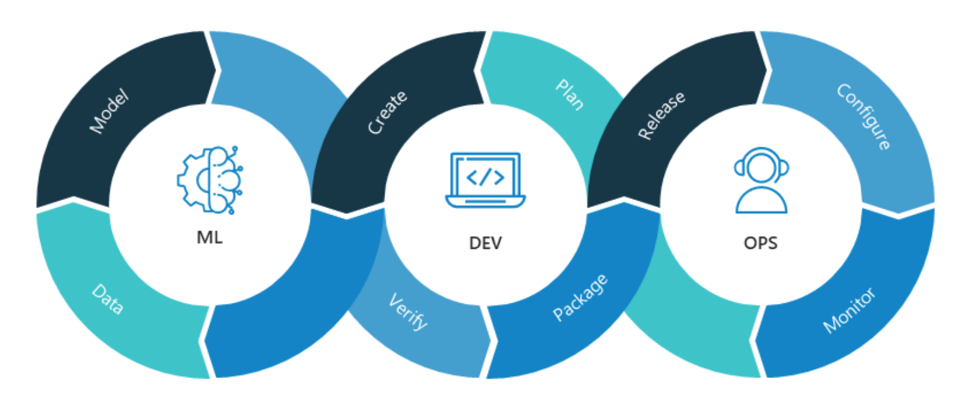
MLOps and DevOps

Slide 15
MLOps and DevOps
MLOps, like DevOps, emerges from the understanding that separating the ML model development from the process that delivers it — ML operations — lowers quality, transparency, and agility of the whole intelligent software.
MLOps and DevOps share:
Automation
Collaboration and increased communication between teams
Continuous integration
Continuous delivery
Data-driven approach, focused on incremental progress (Kaizen)
MLOps and DevOps DO NOT share:
The complexity of the environment, including the fact that machine learning models are made up of both code and data (changing even faster than code)

Slide 16
MLOps and DevOps (Differences)
MLOps is much more experimental in nature. Data Scientists and ML/DL engineers have to tweak various features – hyperparameters, parameters, and models – while also keeping track of and managing the data and the code base for reproducible results.
Hybrid team composition: the team needed to build and deploy models in production won’t be composed of software engineers only.
Testing: testing an ML system involves model validation, model training, and so on – in addition to the conventional code tests, such as unit testing and integration testing.
Automated Deployment: you can’t just deploy an offline-trained ML model as a prediction service. You’ll need a multi-step pipeline to automatically retrain and deploy a model.
Production degradation: ML models in production can have reduced performance not only due to suboptimal coding but also due to constantly evolving data profiles.
A discrepancy between how you handle data in the training and serving pipelines.
A change in the data between when you train and when you serve.
Feedback loop – when you choose the wrong hypothesis (i.e. objective) to optimize, which makes you collect biased data for training your model. Then, without knowing, you collect newer data points using this flawed hypothesis making the model even more biased (the snowball keeps growing)
Monitoring: models in production need to be monitored. Similarly, the data that built the model need to be monitored. These statistics can and will change over time, you need notifications when values deviate from your expectations.

Slide 17
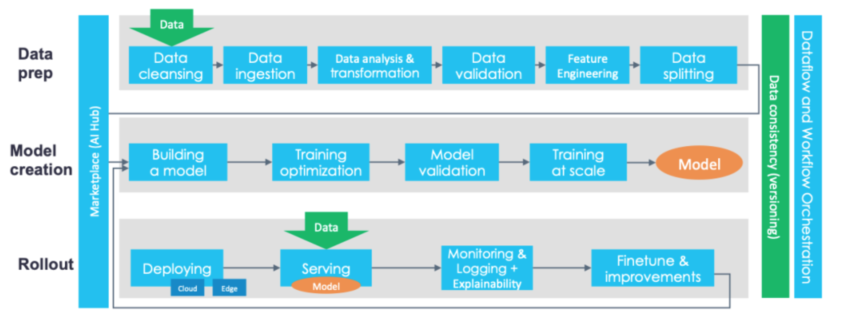
MLOps and DevOps (Differences)
Continuous Integration (CI) is no longer only about testing code, but also testing data, and models.
Continuous Deployment (CD) is no longer about a single software package or service, but a system (an ML training pipeline) that should automatically deploy another service (model prediction service) or roll back changes from a model.
Continuous Testing (CT) is a new property that’s concerned with automatically retraining and serving the models.
Continuous Monitoring (CM) is a new property that’s concerned with automatically monitoring the models (not only hardware/applications).

Slide 18
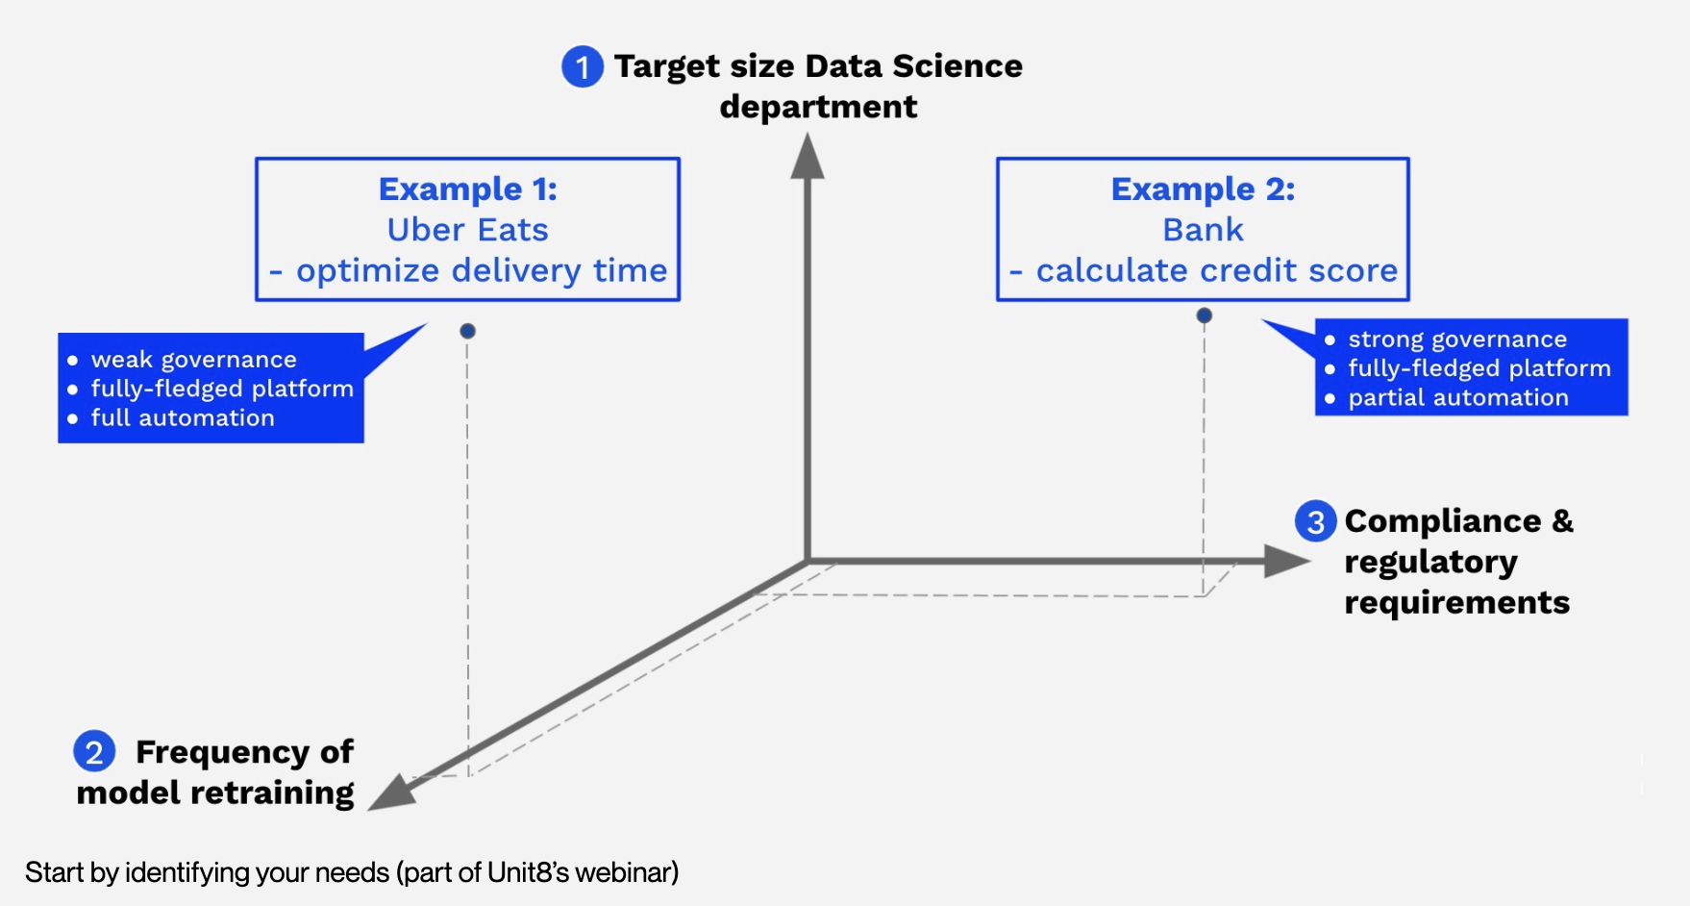
MLOps

Slide 19
Other OPs
ModelOps is more general than MLOps, as it’s not only about machine learning models but any kind of model (e.g., rule-based models).
DataOps is a set of practices, processes and technologies that combines data with automation and methods from agile software engineering to improve quality, speed, and collaboration and promote a culture of continuous improvement in the area of data analytics.
AIOps is another topic entirely and refers to the process of solving operational challenges through the use of artificial intelligence (i.e., AI for DevOps). For example, predictive maintenance alerting DevOps teams to possible problems before they arise.

Slide 20
ML/AI-related risks

Slide 21
ML/AI Risk sources
Business organization
Runtime environment
Reality changes
Business changes
Scale and Automation

Slide 22
Risk sources (business)
The ML life cycle involves people from the business, data science, IT teams. None of these groups use the same tools or even share the same skills to serve as a baseline of communication. Most data scientists are specialized in model building and assessment, and they are not necessarily experts in writing applications.
Leads to: bugs, implementations not matching business questions, inconsistencies between testing and running environments
Requires: more specialized division of labour
Business always changes. Results need to be continually relayed back to the business to ensure that the reality of the model in production aligns with expectations and, critically, addresses the original problem or meets the original goal.
Leads to: new business goals, new data, new models, new training processes
Requires: CD/CI, automated tests, containerized environments

Slide 23
Risk sources (environment)
Learning performance is often very sensitive to the production environment it is running in. Models are often built on a pile of open source software (e.g., libraries, like scikit-learn, Python, or Linux). Production and development versions must match.
Leads to: inconsistencies in model behaviour (hard to find and debug)
Requires: CD/CI, automated tests, containerized environments
Reality (and subsequently data) always changes.
Leads to: data drift, concept drift, training skew
Requires: constant monitoring for understand whether retrained models are better than the previous versions and ensuring that model performance is not degrading in production. Also requires data versioning.

Slide 24
Scale and automation
Until models were managed at a small scale there was less interest in understanding them and their dependencies.
With scale and decision automation (an increasing prevalence of decision-making without human intervention)
models become more critical
managing risk becomes more important at the top level (management is responsible for models).
Introducing automation vis-à-vis machine learning models shifts accountability from the bottom of the hierarchy to the top.
Decisions that were previously made by individual contributors who operated within guidelines (for example, what the price of a given product should be) are now being made by a model. The person responsible for the automated decisions is likely a data team manager or even executive.

Slide 25
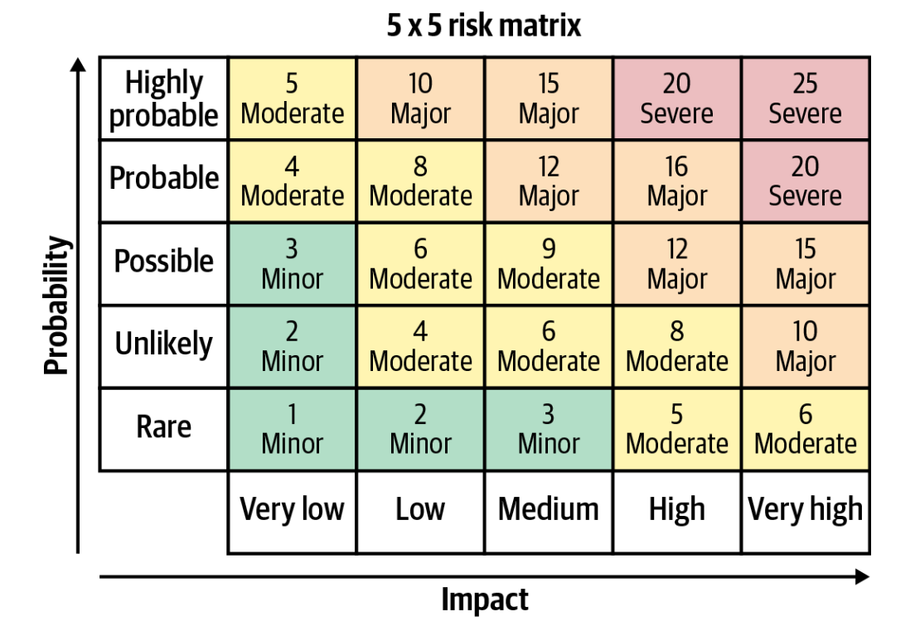
Risk assessment
In machine learning models, risks vary widely. For example, the stakes are much lower for a recommendation engine used once a month to decide which marketing offer to send a customer than for a travel site whose pricing and revenue depend on a machine learning model.
The risk that the model is unavailable for a given period of time (infrastructure)
The risk that the model returns a bad prediction for a given sample (model)
The risk that the model accuracy or fairness decreases over time (data)
The risk that the skills necessary to maintain the model are lost (organization)

Slide 26
Responsible AI
Intentionality: models are designed and behave in ways aligned with their purpose. This includes the assurance that data used for AI projects comes from compliant and unbiased sources plus a collaborative approach to AI projects that ensures multiple checks and balances on potential model bias.
Explainability: the results of AI systems should be explainable by humans (ideally, not just the humans who created the system).
Accountability: overall view of which teams are using what data, how, and in which models. It also includes the need for trust that data is reliable and being collected in accordance with regulations as well as a centralized understanding of which models are used for what business processes.
Traceability: if something goes wrong, the ability to find where in the pipeline it happened.

Slide 27
ML/AI Organizational Roles

Slide 28
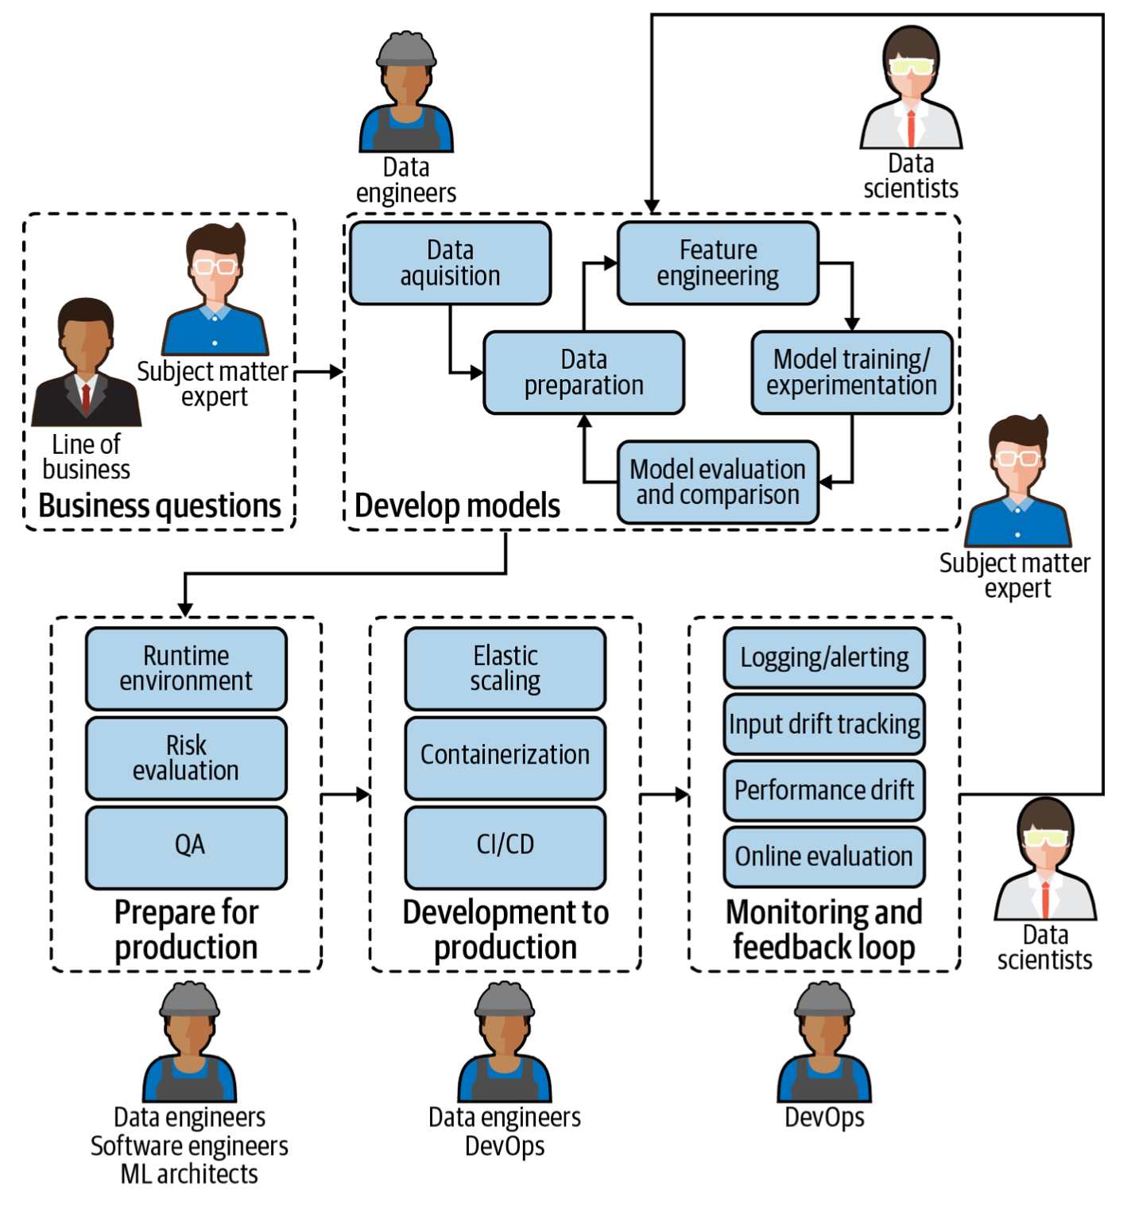
ML/AI Organizational Roles
MLOps involves a diverse group of experts across the organization.
Each person from the subject matter expert to the most technical machine learning architect plays a critical part in the maintenance of ML models in production.
This is ultimately important not only to ensure the best possible results from ML models (good results generally lead to more trust in ML-based systems as well as an increased budget to build more), but also to protect the business from risk.

Slide 29
Subject matter experts
Provide business questions, goals, or KPIs (Key Performance Indicator) around which ML models should be framed.
Continually evaluate and ensure that model performance aligns with the initial need.
MLOps requirements
Easy way to understand deployed model performance in business terms.
Mechanism or feedback loop for flagging model results that don’t align with business expectations.

Slide 30
Data scientists
Build models that address the needs of subject matter experts.
Deliver operationalizable models so that they can be properly used in the production environment.
Assess model quality (of both original and tests) in tandem with subject matter experts to ensure they answer business questions.
MLOps requirements
Automated model packaging and delivery for quick and easy (yet safe) deployment to production.
Ability to develop tests to determine the quality of deployed models and to make continual improvements.
Visibility into the performance of all deployed models (including side-by-side for tests) from one central location.

Slide 31
Data engineers
Integrate ML models in the company’s applications and systems.
Ensure that ML models work seamlessly with other non-machine-learning-based applications.
MLOps requirements
Versioning and automatic tests.
The ability to work in parallel on the same application.

Slide 32
Software engineers
Optimize the retrieval and use of data to power ML models.
MLOps requirements
Visibility into performance of all deployed models.
Ability to see the full details of individual data pipelines to address underlying data plumbing issues.

Slide 33
ML architects
Ensure a scalable and flexible environment for ML model pipelines, from design to development and monitoring.
Introduce new technologies when appropriate that improve ML model performance in production.
MLOps requirements
A high-level overview of models and their resources consumed.
Ability to drill down into data pipelines to assess and adjust infrastructure needs.

Slide 34
Model risk managers/auditors
Minimize overall risk to the company as a result of ML models in production.
Ensure compliance with internal and external requirements before pushing ML models to production.
MLOps requirements
Robust, likely automated, reporting tools on all models (currently or ever in production), including data lineage.

Slide 35
DevOps
Conduct and build operational systems and test for security, performance, availability
CI/CD pipeline management
CT/CM pipeline management
MLOps requirements
Seamless integration of MLOps into the larger DevOps strategy of the enterprise.
Seamless deployment pipeline.

Slide 36
Designing ML-powered Software

Slide 37
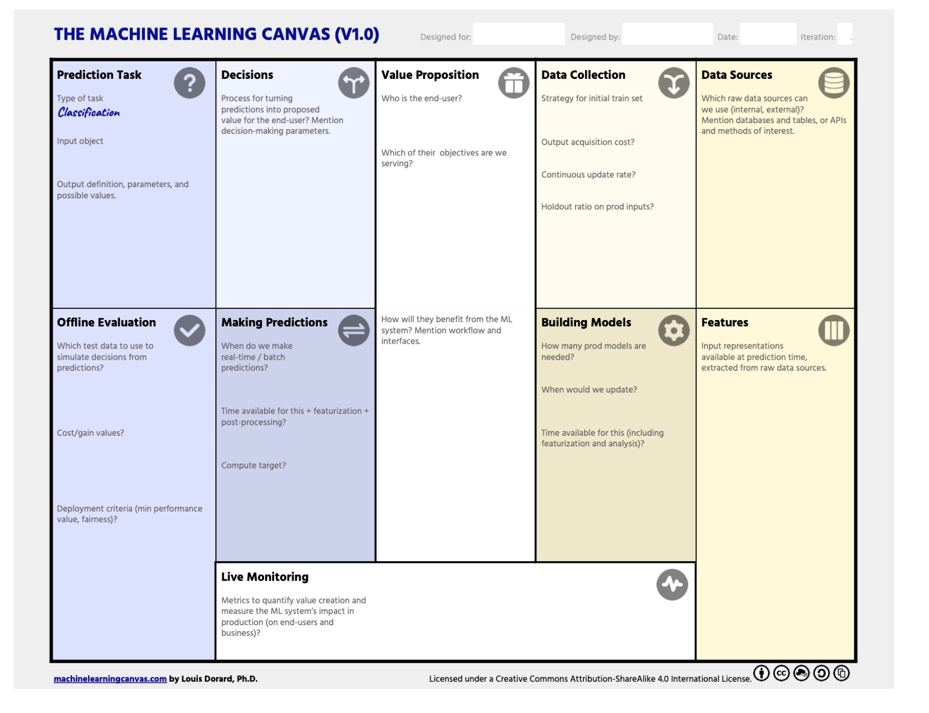
Machine Learning Canvas
The ML Canvas lets you lay down your vision for your ML system and communicate it with your team.
Connect what ML can do to your organization’s objectives, and towards assessing feasibility.
Identify key constraints of ML system, which have an impact on the technology to choose.
Describe how your ML system will turn predictions into value for end-users, which data it will learn from, and how to make sure it will work as intended.
Anticipate costs, identify bottlenecks, specify requirements, and create a roadmap.
https://www.ownml.co/machine-learning-canvas

Slide 38
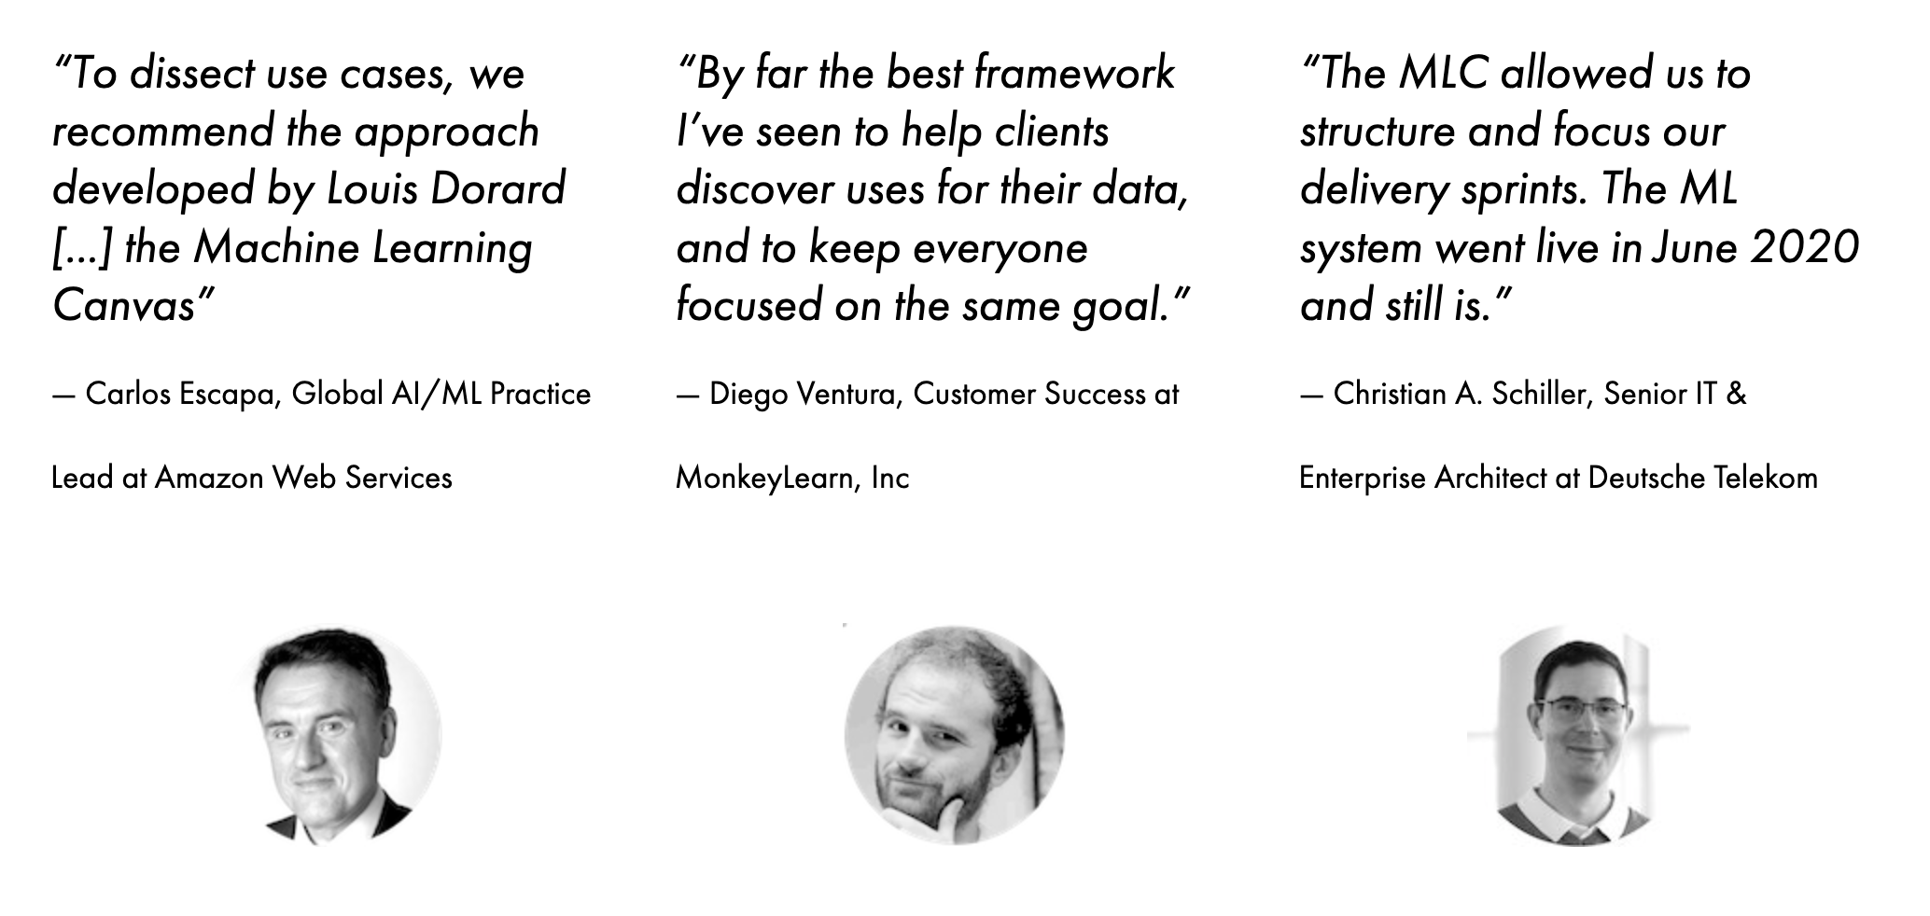
Machine Learning Canvas

Slide 39
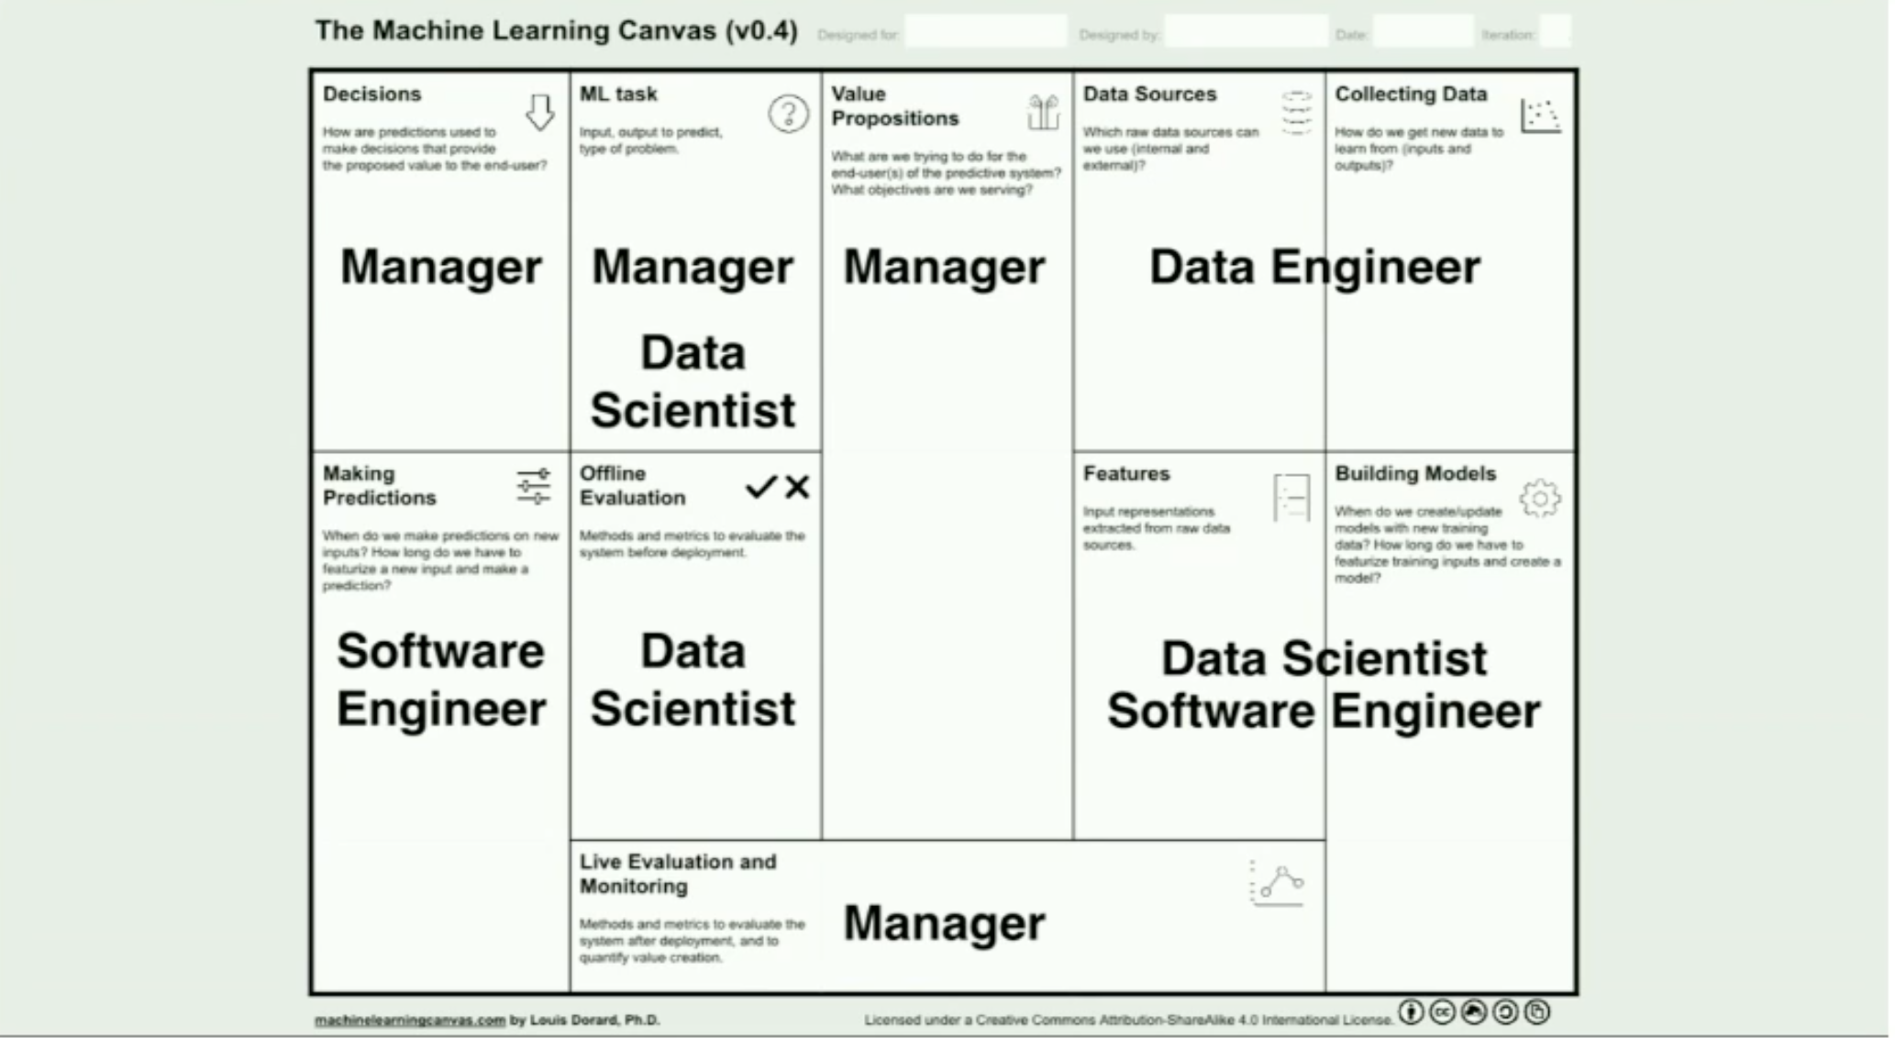
Machine Learning Canvas

Slide 40
Machine Learning Canvas
Value Proposition
This is the crucial blocks in the whole canvas. Here we should answer three important questions:
What is the problem? What objective are we serving? What are we trying to do for the end-user?
Why is it important?
Who is the end-user?

Slide 41
Machine Learning Canvas
Data Sources
In this block, we clarify all available and possible data sources to be used for the ML task.
Internal/external databases
Data marts, OLAP cubes, data warehouses, OLTP systems
Hadoop clusters
REST APIs to gather data
Static files, spreadsheets
Web scraping
The output of other (ML) systems
Open-source data sets

Slide 42
Machine Learning Canvas
Data Collection
Gathers information about new data that should be collected in order to re-train the ML model. Prevents the ML model decay phenomenon.
How do we label the new data?
How expensive is it to collect new data?
How expensive is it to process rich media like images, sound, or video?
Is there human in the loop for the manual cleaning and labelling of the incoming data?
Initial dataset (timeframe)?

Slide 43
Machine Learning Canvas
Prediction Task
After clarifying what data is available, we brainstorm what type of ML should be used. Here are some examples of questions that might clarify the ML Task:
Recommendation, regression, classification, clustering?
What is the input for a prediction task? (e.g. E-mail text)
What is the output of the prediction task? (e.g. spam)
What is the degree of complexity our ML Model could assume? (e.g. is our model a combination of other ML models? Do we employ ensemble learning?)
What are the complexity costs, such as training and inference time, for the above models?

Slide 44
Machine Learning Canvas
Decisions
How are prediction used to make decisions?
How does the end-user or the system interacts with the model predictions?
e.g. What happens if the user gets a list of product recommendations? What happens if the incoming e-mail is classified as “spam”?
Are there hidden costs in decision making, such as human in the loop?
Such information is required to later decide on how to deploy the ML model.

Slide 45
Machine Learning Canvas
Live Monitoring
After deployment, the ML model should be evaluated and here we would need to specify both model and business metrics, which should correlate.
Generally, the metrics should follow the S.M.A.R.T methodology and be: Specific, Measurable, Achievable, Relevant, and Time-bound.
How do we track the system performance?
e.g. A/B Testing
How do we evaluate the value creation?
e.g users spent less time on the inbox.

Slide 46
Machine Learning Canvas
Features
As every ML algorithm requires input data in the form of features, we should clarify how should the input data be represented.
How do we extract features from raw sources?
Consider to include domain experts to specify what data aspects are most important for the particular ML task.

Slide 47
Machine Learning Canvas
Building Models
Regards updating the ML models, because different ML tasks require different frequencies of model re-training:
How often the model should be retrained?
e.g. hourly, weekly, or with every new data point.
What are the hidden costs for model re-training?
do we use cloud resources to perform such tasks?
what is the price policy of the cloud vendor?
how should we perform hardware cost estimation?
How long will it take to re-train the model?
How do we deal with the scaling issues of cloud operations as they can be more complex and costly?
Do we plan for change in the tech stack?
e.g. how can we deal with the tech stack evolution as new tools and development workflows are emerging in the modern AI?

Slide 48
Machine Learning Canvas
Offline Evaluation
Domain specific metrics that justify the deployment of the ML model. For example, simulated with the training and testing data, would the prediction of the model generate more revenue than the revenue created in the “traditional” way.
What technical evaluation metrics should be used?
Precision, Recall, F-1 measure.
Accuracy.
What is the meaning of model prediction errors such as false positives and false negatives?
How much test data do we need to be confident that the ML model performs well?

Slide 49
Machine Learning Canvas
Making Predictions
This block includes information about when we make a prediction on new inputs.
When should predictions be available?
New predictions are made each time when the user opens the app, such as recommendations.
New predictions are made on request.
New predictions are made on schedule.
Are predictions made on the fly for each data point or for a batch of the input data?
How computationally complex could the model inference get in the application?
Is there a human in the loop to support in making predictions?

Slide 50
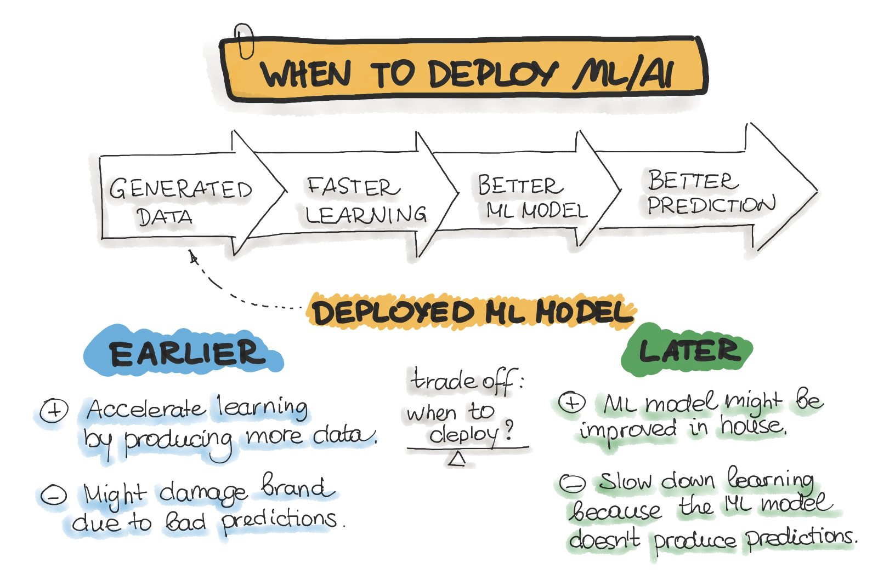
Should/When we deploy AI/ML?
The effort to fill out the Machine Learning Canvas might initiate an existential discussion regarding the real objective and hidden costs of the ML-software.
Such a discussion might result in a decision not to implement AI/ML at all. Possible reasons can be as follows:
The solution to our problem does not tolerate wrong predictions.
Implementing AI/ML would generate a low ROI.
The maintenance of the ML/AI project is not guaranteed or is too expensive

Slide 51
An Overview of the End-to-End Machine Learning Workflow

Slide 52
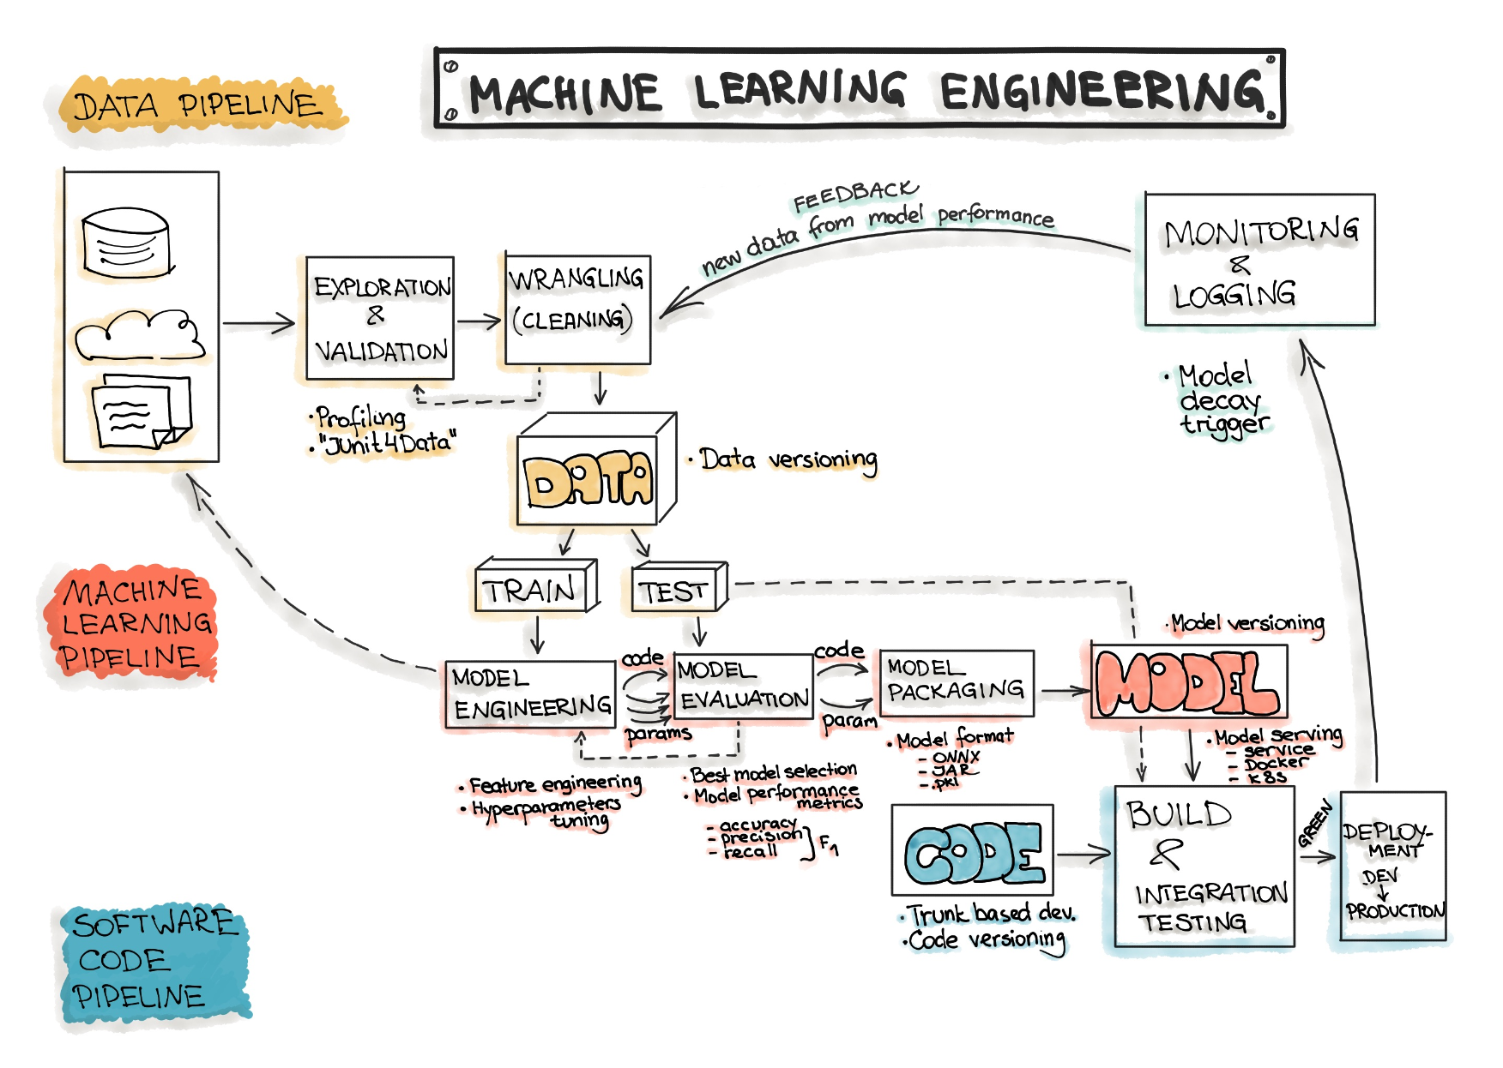
Data, Model, and Code
Generally, the goal of a machine learning project is to build a statistical model by using collected data and applying machine learning algorithms to them.
ML-based software includes three main artifacts: Data, ML Model, and Code.
Accordingly, the typical machine learning workflow consists of three main phases:
Data Engineering
Model Engineering
Model Operationalization

Slide 53
Data Engineering

Slide 54
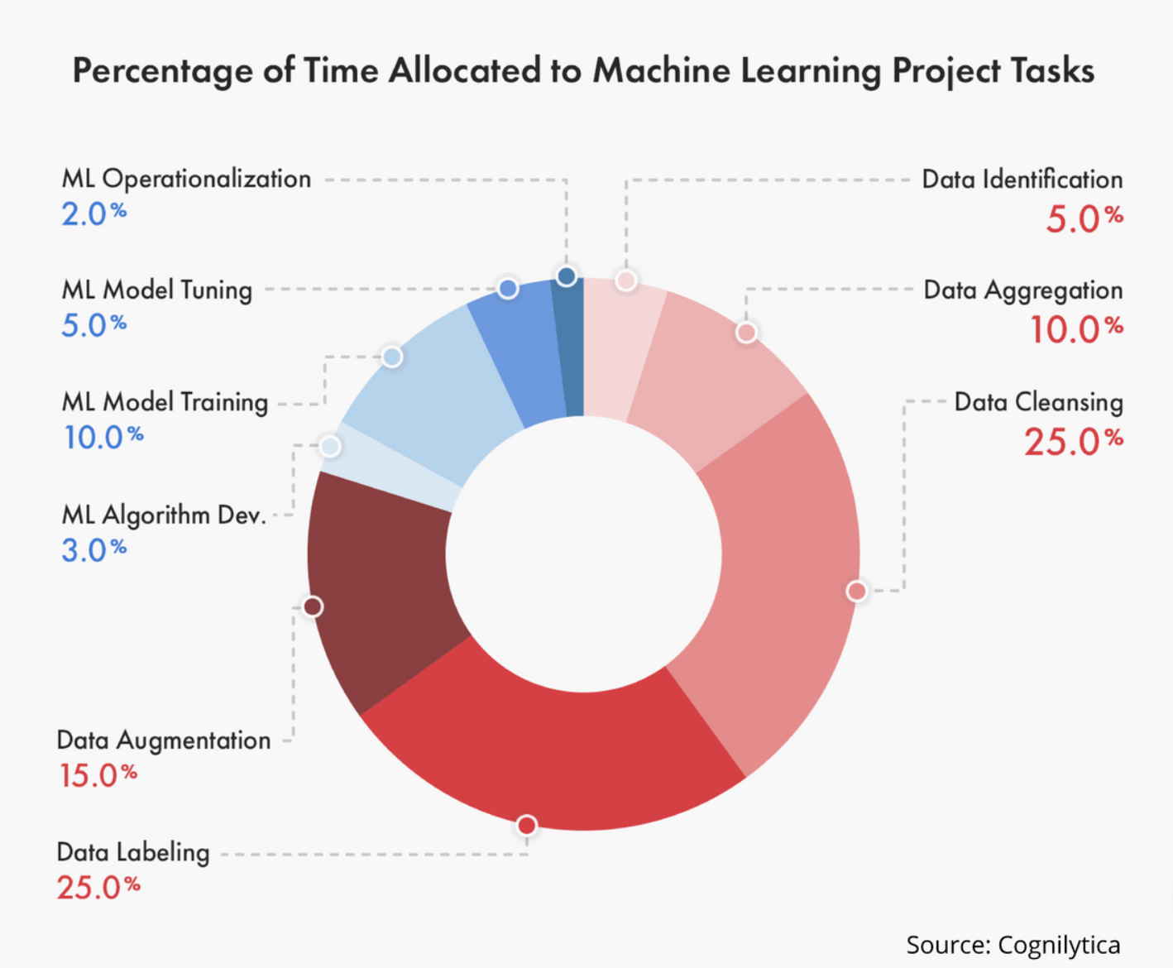
Data Engineering
The Data Engineering pipeline includes a sequence of operations on the available data that leads to supplying training and testing datasets for the machine learning algorithms:
Data Ingestion - Collecting data by using various frameworks and formats, such as Spark, HDFS, CSV, etc. This step might also include synthetic data generation or data enrichment.
Data Versioning - Data versioning is the storage of different versions of data that were created or changed at specific points in times.
Exploration and Validation - Includes data profiling to obtain information about the content and structure of the data. The output of this step is a set of metadata, such as max, min, avg of values. Data validation operations are user-defined error detection functions, which scan the dataset in order to spot some errors.
Data Wrangling (Cleaning) - The process of re-formatting particular attributes and correcting errors in data, such as missing values imputation.
Data Labeling - The operation of the Data Engineering pipeline, where each data point is assigned to a specific category.
Data Splitting - Splitting the data into training, validation, and test datasets to be used during the core machine learning stages to produce the ML model.

Slide 55
Ingestion
Data Ingestion - Collecting data by using various systems, frameworks and formats, such as internal/external databases, data marts, OLAP cubes, data warehouses, OLTP systems, Spark, HDFS etc.
This step might also include synthetic data generation or data enrichment.
The amount and quality of the data set are usually problem-specific and can be empirically discovered.
Store Data: Data Sources, Space Estimation and Space Location
Back up Data: keep the original dataset untouched.
Privacy Compliance: Ensure sensitive information is deleted or protected (e.g., anonymized) to ensure GDPR compliance.
Metadata Catalog: Start documenting the metadata of the dataset by recording the basic information about the size, format, aliases, last modified time, and access control lists.

Slide 56
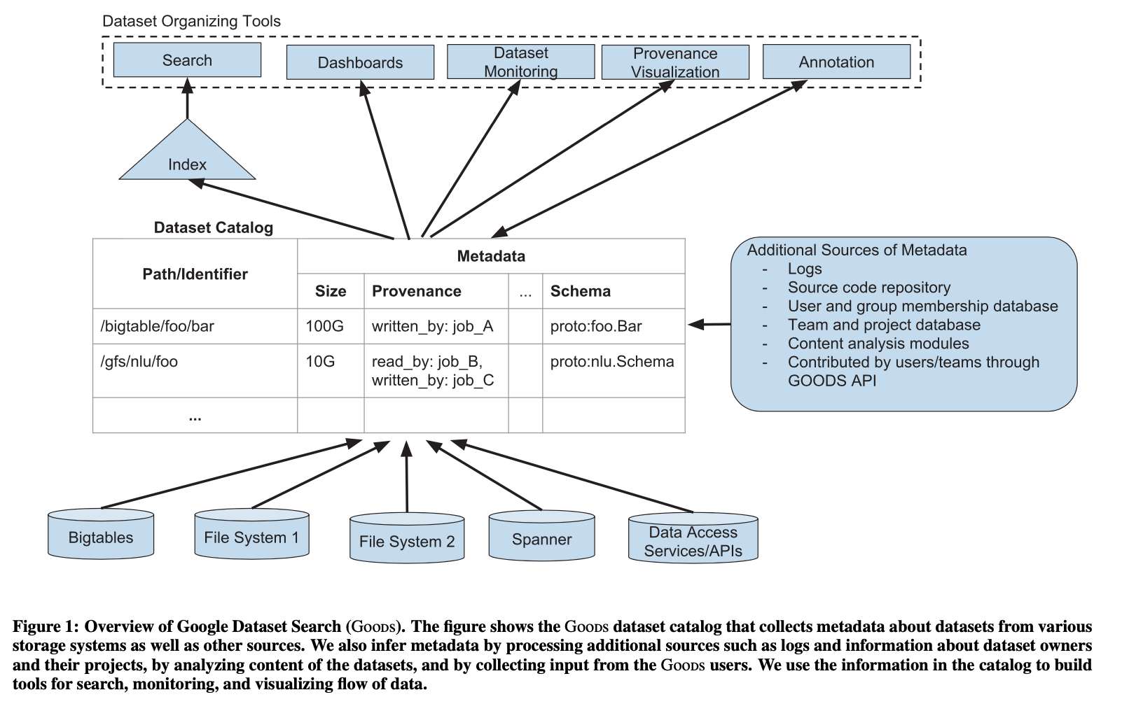
Ingestion
Goods: Organizing Google’s Datasets
Alon Halevy2∗, Flip Korn1, Natalya F. Noy1, Christopher Olston1, Neoklis Polyzotis1, Sudip Roy1, Steven Euijong Whang1

Slide 57
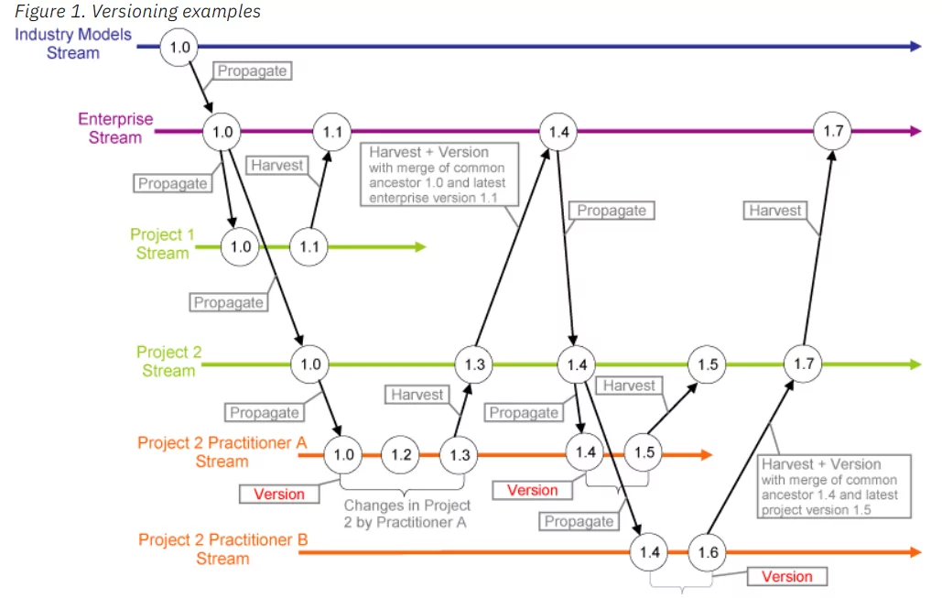
Versioning
Preserving the working version while testing: AI/ML models work with the goal of maximizing business efficiency. It is normal for development teams to test new ways to increase efficiency. Introducing a new dataset into systems could be one of those exercises.
Measuring the business performance: without the intervention of engineers, datasets can change over time. Sales data, for example, is changed by each transaction.
Compliance and auditing benefits: data versioning can help with both internal and external audits and compliance processes by ensuring data is stored from specific times.
Challenges: storage space, security

Slide 58
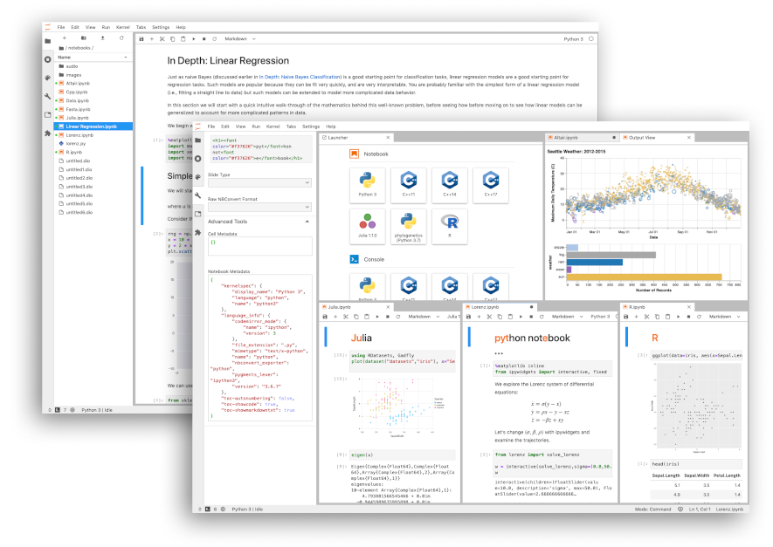
Exploration
Exploration profiles the content and structure of the data. The output of this step is a set of metadata, such as max, min, average of values
Name
Number of Records
Data Type (categorical, numerical, int/float, text, structured, etc.)
Numerical Measures (min, max, average, median, etc. for numerical data)
Amount of missing values (or “missing value ratio” = Number of absent values/ Number of records)
Type of distribution (Gaussian, uniform, logarithmic, etc.)
Data Visualization: build a visual representation for value distribution.
Attributes Correlation: compute and analyze the correlations between attributes
https://www.kaggle.com/datasets/ruchi798/data-science-job-salaries

Slide 59
Validation
Data validation refers to the process of ensuring the accuracy and quality of data. It is implemented by building several checks into a system or report to ensure the logical consistency of input and stored data.
Data Type Check: For example, a field might only accept numeric data. If this is the case, then any data containing other characters such as letters or special symbols should be rejected by the system.
Code Check: For example, it is easier to verify that a postal code is valid by checking it against a list of valid codes.
Range Check: For example, latitude and longitude are commonly used in geographic data. A latitude value should be between -90 and 90, while a longitude value must be between -180 and 180. Any values out of this range are invalid.
Format Check: For example, Many data types follow a certain predefined format. A common use case is date columns that are stored in a fixed format like “YYYY-MM-DD” or “DD-MM-YYYY.”
Consistency Check: For example, checking if the delivery date is after the shipping date for a parcel.
Uniqueness Check: For example, checking that an item is not entered multiple times into a database.

Slide 60
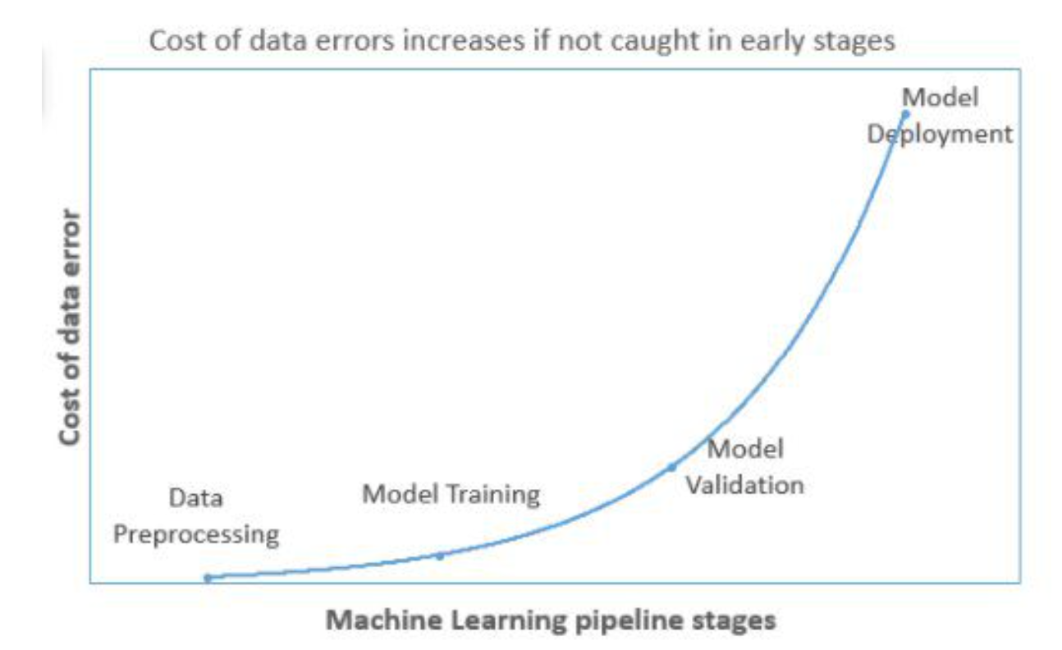
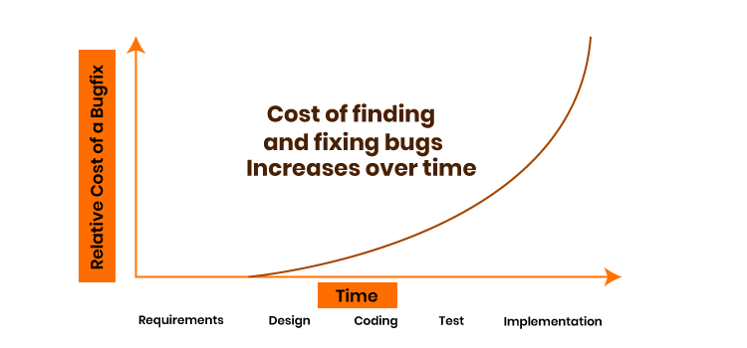
Validation (Statistical)
garbage in garbage out
Models get re-trained with incremental data. The model makes predictions with new incoming data and the same data is added with actual labels and used for retraining.
Since In each iteration, newly added data is generally a small fraction of overall training data, hence, the changes in model accuracy will be easily missed and the errors will keep adding with time. ​​​​​​​ ​​​​​​​​​​​​​​
https://www.kdnuggets.com/2021/05/data-validation-machine-learning-imperative.html

Slide 61
Wrangling
Wrangling includes the following operations (from the book “Principles of Data Wrangling”)
Reordering record fields by moving columns
Creating new record fields through extracting values
Combining multiple record fields into a single record field
Filtering datasets by removing sets of records
Shifting the granularity of the dataset and the fields associated with records through aggregations and pivots.
Fixing or removing outliers
Dealing with missing values (NaN can be replaced with mean, mode, the most frequent value of the column or simply by dropping the row).
Reshaping data according to the requirements, where new data can be added or pre-existing data can be modified.
https://www.geeksforgeeks.org/data-wrangling-in-python/

Slide 62
Labelling
Data labeling is the process of identifying raw data (images, text files, videos, etc.) and adding one or more meaningful and informative labels to provide context so that a machine learning model can learn from it.
Accuracy in data labeling measures how close the labeling is to ground truth, or how well the labeled features in the data are consistent with real-world conditions.
Quality in data labeling is about accuracy across the overall dataset. Does the work of all of your labelers look the same? Is labeling consistently accurate across your datasets?
Data labeling includes a wide array of tasks:
Using tools vs data labelers
Quality assurance for data labeling
Training of new team members
Project planning, process operationalization, and measurement of success

Slide 63
Labelling (HITL)
Organizations use a combination of software, processes, and people to clean, structure, or label data. In general, you have four options for your data labeling workforce:
Employees - They are on your payroll, either full-time or part-time. Their job description may not include data labeling.
Managed teams - You use vetted, trained, and actively managed data labelers (e.g., CloudFactory).
Contractors - They are temporary or freelance workers.
Crowdsourcing - You use a third-party platform to access large numbers of workers at once.
How is quality measured in data labeling?
Gold standard - There’s a correct answer for the task. Measure quality based on correct and incorrect tasks.
Sample review - Select a random sample of completed tasks. A more experienced worker, such as a team lead or project manager, reviews the sample for accuracy.
Consensus - Assign several people do the same task, and the correct answer is the one that comes back from the majority of labelers. Intersection over union (IoU) is a consensus model often used in object detection within images. It combines people and automation to compare the bounding boxes of your hand-labelled ground truth images with the predicted bounding boxes from your model.

Slide 64
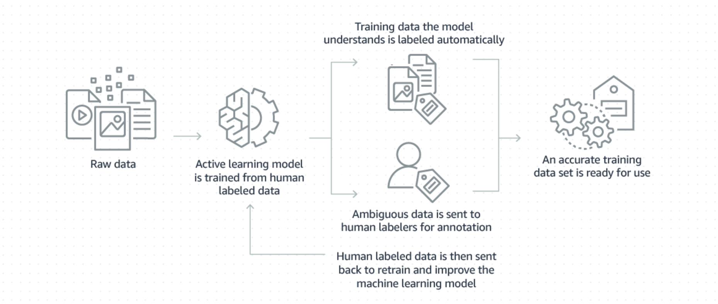
Labelling (AUTO)

Slide 65
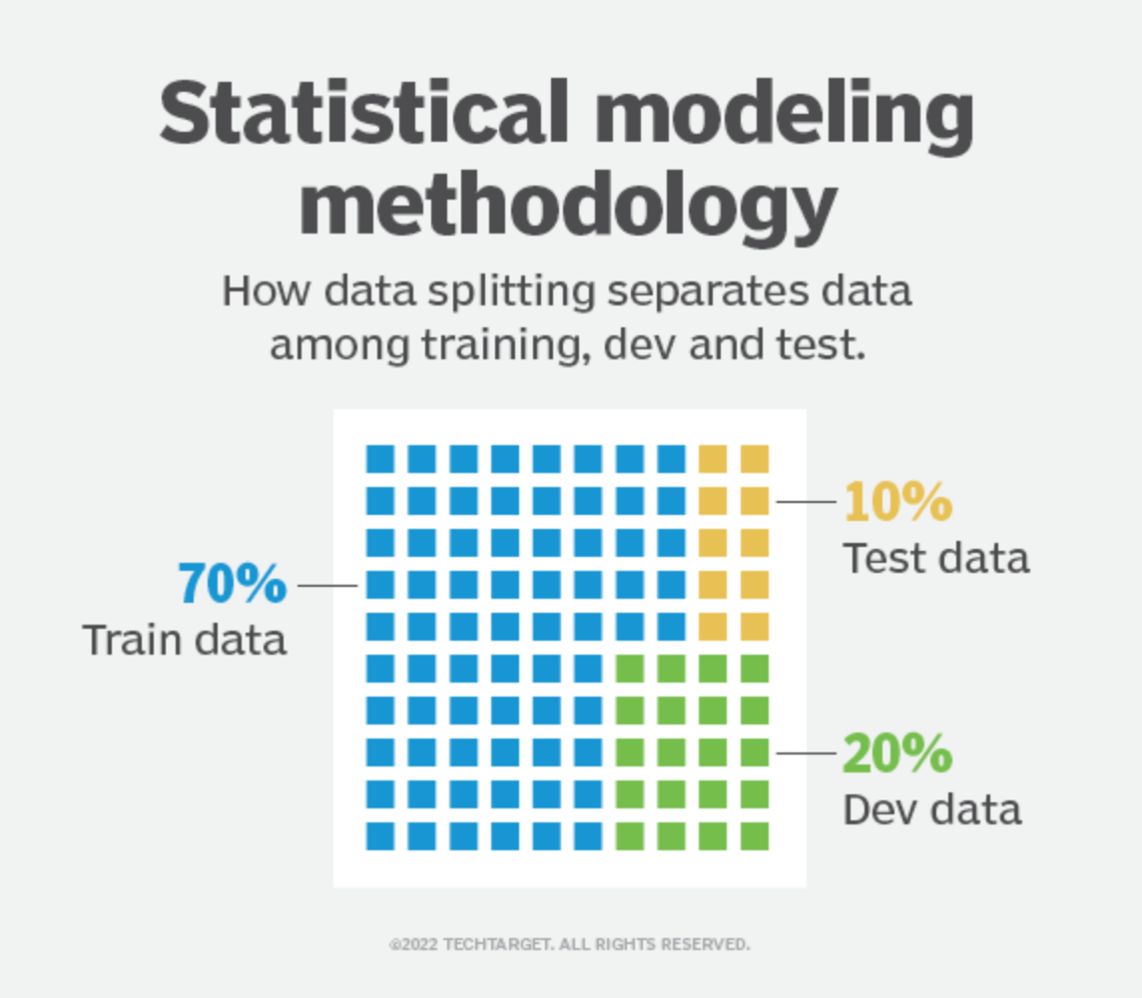
Splitting
The original data in a machine learning model is typically taken and split into three sets:
The training set is the portion of data used to train the model. The model should observe and learn from the training set, optimizing any of its parameters.
The dev set is a data set of examples used to change learning process parameters (cross-validation). This set of data has the goal of ranking the model's accuracy and can help with model selection.
The testing set is the portion of data that is tested in the final model and is compared against the previous sets of data. The testing set acts as an evaluation of the final model and algorithm.

Slide 66
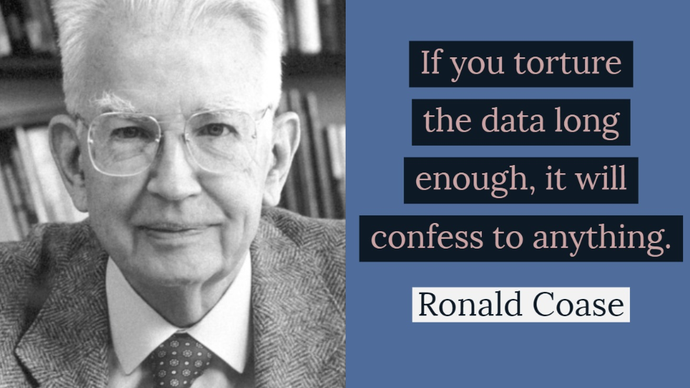
Splitting and “data snooping”
Sample a test set, put it aside, and never look at it to avoid the “data snooping” bias. You fell for this if you are selecting a particular kind of ML model by using the test set.
This will lead to an ML model selection that is too optimistic and will not perform well in production (overfitting).
https://datascience.stanford.edu/news/data-snooping

Slide 67
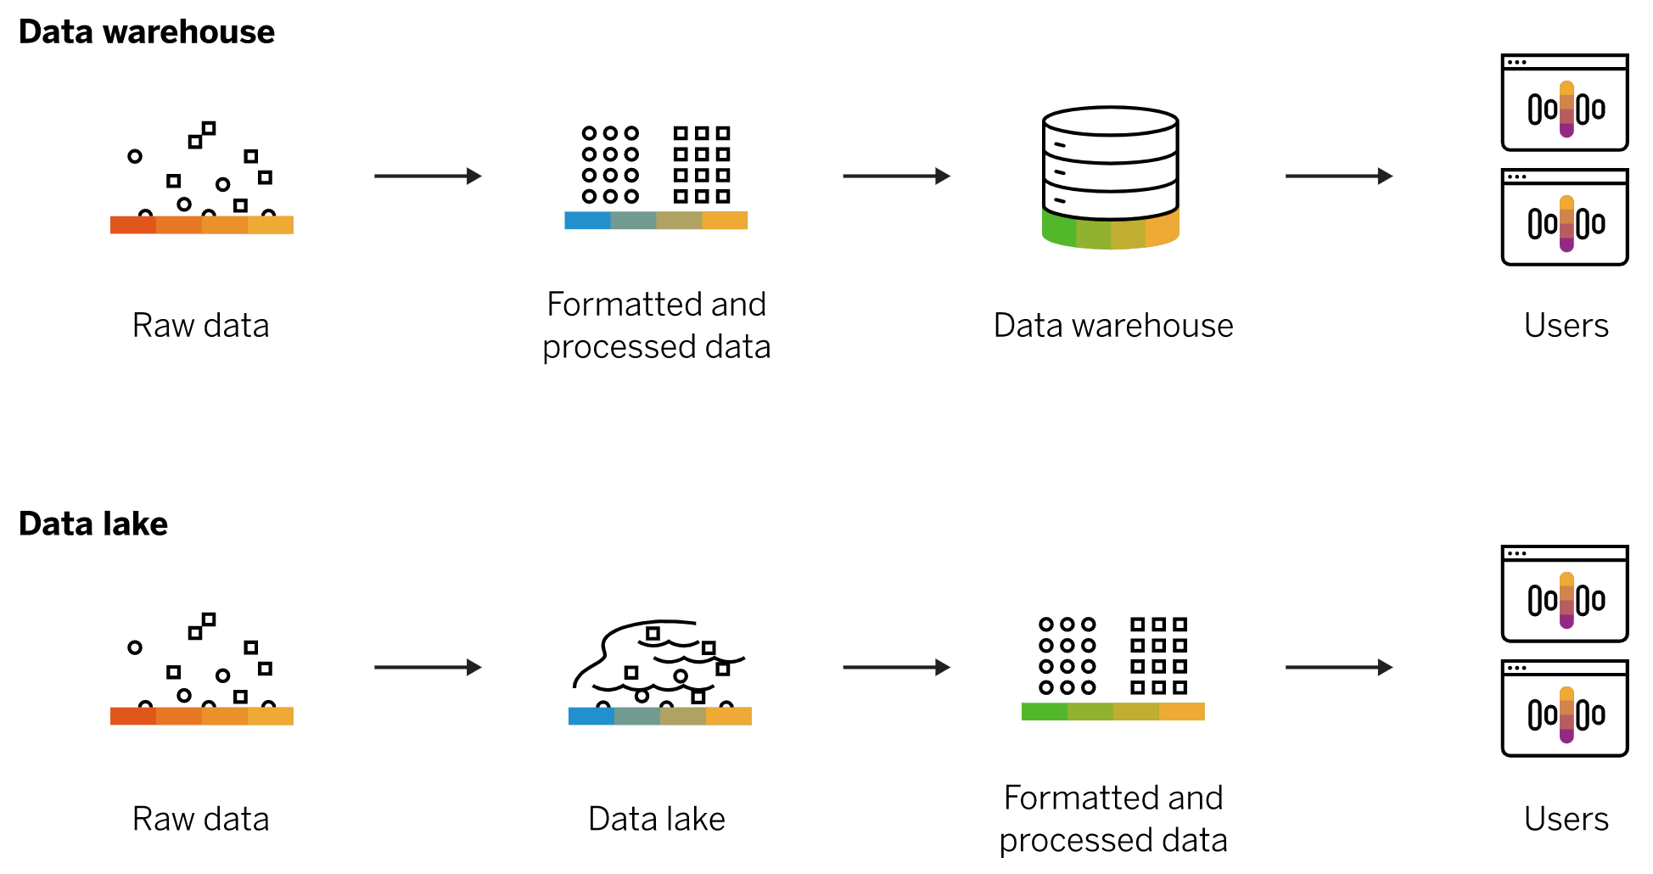
Storage Platforms
A data lake is a vast pool of raw data, the purpose for which is not yet defined.
A data warehouse is a repository for structured, filtered data that has already been processed for a specific purpose.
The distinction is important because they serve different purposes and require different sets of eyes to be properly optimized. While a data lake works for one company, a data warehouse will be a better fit for another.
There is even an emerging data management architecture trend of the data lakehouse, which combines the flexibility of a data lake with the data management capabilities of a data warehouse.

Slide 68
Model Engineering

Slide 69
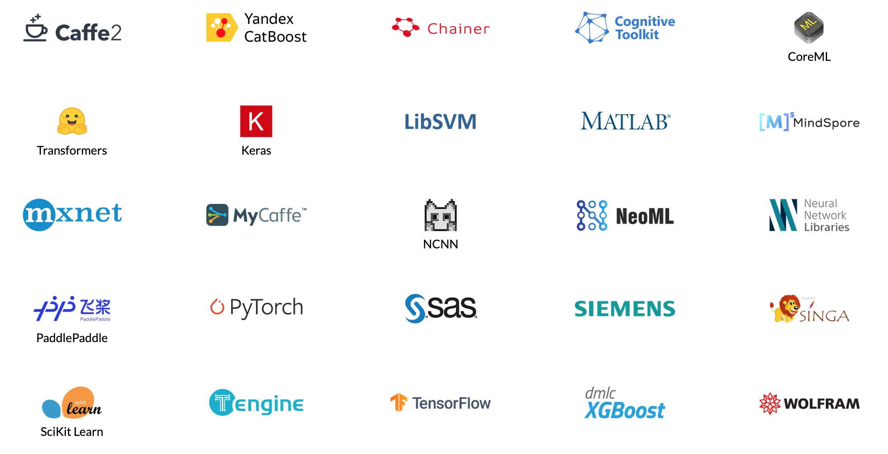
Model Engineering
The Model Engineering pipeline includes a number of operations that lead to a final model:
Model Training - The process of applying the machine learning algorithm on training data to train an ML model. It also includes feature engineering and the hyperparameter tuning for the model training activity.
Model Evaluation - Validating the trained model to ensure it meets original objectives before serving the ML model in production.
Model Testing - Performing the final “Model Acceptance Test” by using the hold test dataset.
Model Packaging - The process of exporting the final ML model into a specific format (e.g. ONNX), which describes the model, in order to be consumed by the business application.

Slide 70
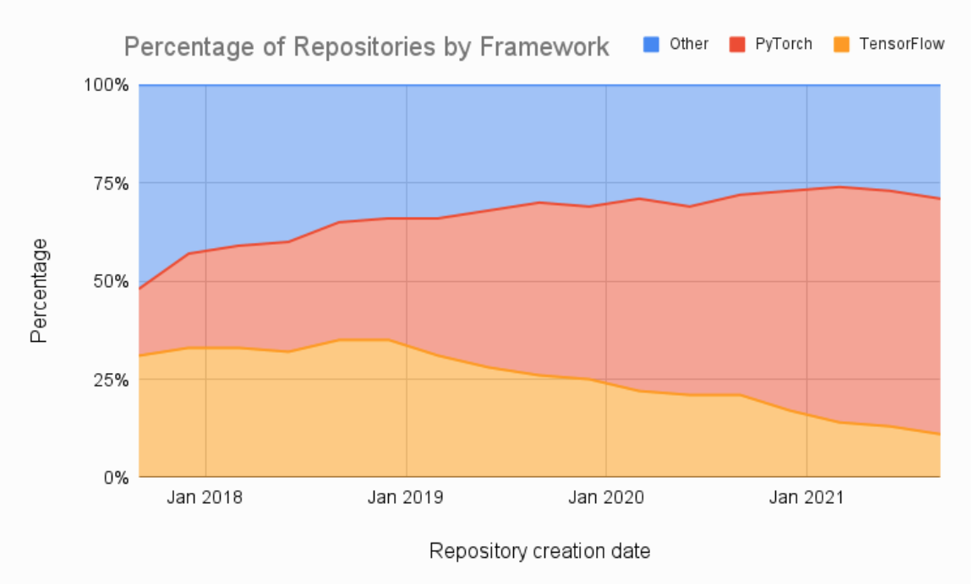
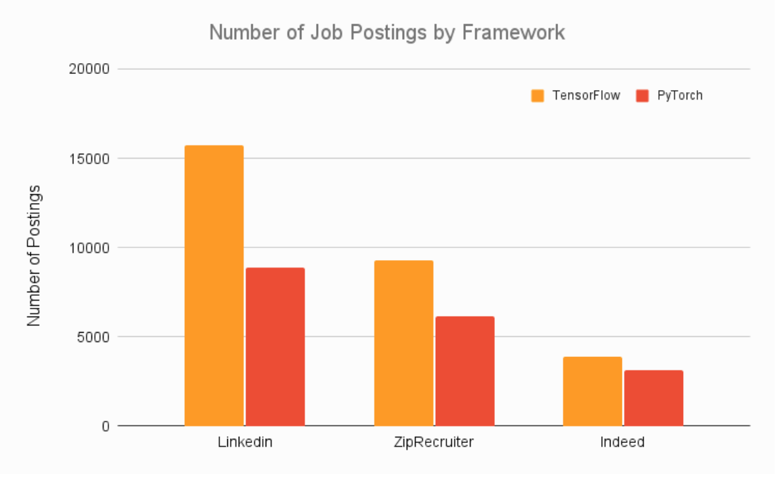
Model Training
Train many ML models from different categories (e.g., linear regression, logistic regression, k-means, naive Bayes, SVM, Random Forest, etc.) using standard parameters.
Measure and compare their performance. For each model, use N-fold cross-validation and compute the mean and standard deviation of the performance measure on the N folds.
Error Analysis: analyze the types of errors the ML models make.
Consider Ensemble methods such as majority vote, bagging, boosting, or stacking. Combining ML models should produce better performance than running them individually. (Further reading “Ensemble Methods: Foundations and Algorithms” by Zhi-Hua Zhou)
Every ML model specification (code that creates an ML model) should go through a code review and be versioned.

Slide 71
Model Training (Features Engineering)
Numerical imputation: is used to fill gaps in surveys or censuses when certain pieces of information are missing.
Categorical Imputation: When dealing with categorical columns, replacing missing values with the highest value (or Other).
Outlier handling: is a technique for removing outliers from a dataset. This method can be used on a variety of scales to produce a more accurate data representation (removal, replace, capping, discretization)
Log Transform: is used to turn a skewed distribution into a normal or less-skewed distribution. It is used to handle confusing data, and the data becomes more approximative to normal applications.
A one-hot encoding: is a type of encoding in which an element of a finite set is represented by the index in that set, where only one element has its index set to “1” and all other elements are assigned indices within the range [0, n-1].
Scaling: the continuous features become similar in terms of range. Although this step isn’t required for many algorithms, it’s still a good idea to do so (normalization to [0, 1] (after cleaning outliers), stadardization).

Slide 72
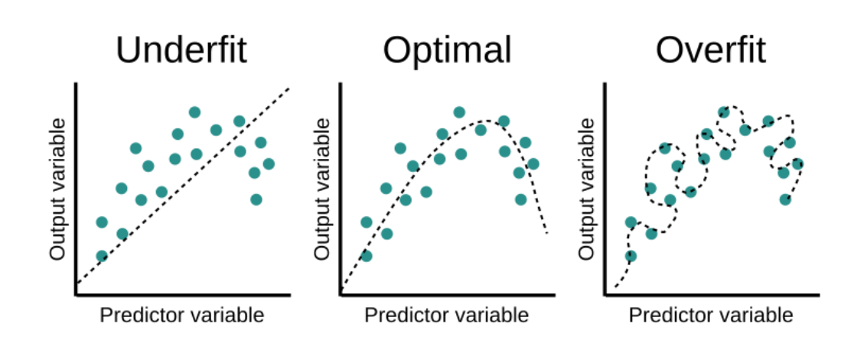
Model Training (hyperparameter tuning)
Model parameters are the properties of the training data that are learned by the ML model during training. So, parameters are internal to the model. For instance, the coefficients in regression or the weights and biases in a neural network are model parameters since they are estimated through the training process.
Model hyperparameters are configurations of the model that are set before and determine the training process. Hyperparameters are external to the model. The “hyper-” prefix implies that they are higher-level parameters that control the learning process. Some examples of hyperparameters include:
Number of hidden layers in a neural network
Number of leaves of a decision tree
Learning rate of a gradient descent
The ratio between the training set and test set

Slide 73
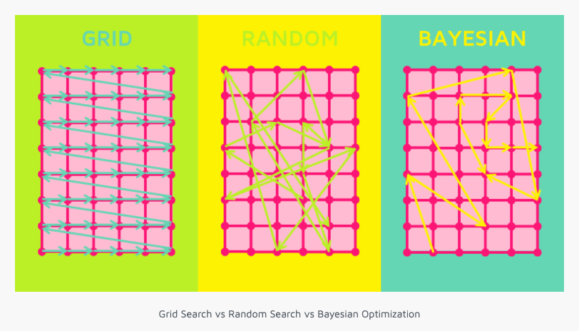
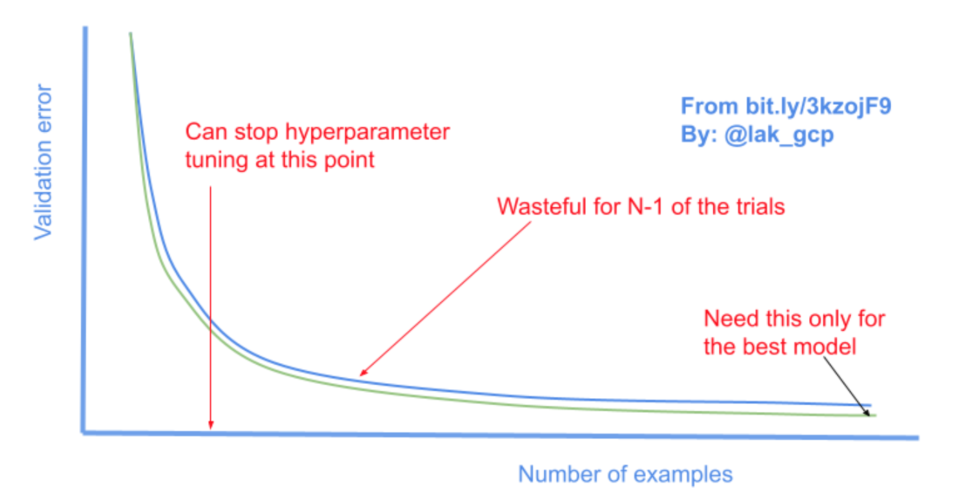
Model Training (hyperparameter tuning)
There are three main methods to find the optimal set of values for hyperparameters:
Grid search is determining a set of values for each hyperparameter, running the model with each possible combination of these values, and picking the set of values that produce the best results. Grid search involves guesswork since the values to be tried are set manually by the practitioner.
Random search involves picking random combinations of hyperparameter values from given statistical distributions to find an optimal set of values. The advantage of random search over grid search is that it allows searching in a wider range of values without increasing the number of trials.
Bayesian search is a sequential method that uses the results of the previous sets of hyperparameters to improve the next search process. Bayesian search reduces the optimization time especially for models trained on a large amount of data.

Slide 74
Model Evaluation
Model evaluation defines:
How well our model is performing
Is our model accurate enough to put into production
Will a larger training set improve my model’s performance?
Is my model under-fitting or over-fitting?
Accuracy measures the proportion of true results to total cases. Aim for a high accuracy rate. accuracy = # correct predictions / # total data points
Log loss is a single score that represents the advantage of the classifier over a random prediction. The log loss measures the uncertainty of your model by comparing the probabilities of it’s outputs to the known values (ground truth). You want to minimize log loss for the model as a whole.
Precision is the proportion of true results over all positive results.
Recall is the fraction of all correct results returned by the model.
F1-score is the weighted average of precision and recall between 0 and 1, where the ideal F-score value is 1.
AUC measures the area under the curve plotted with true positives on the y axis and false positives on the x axis. This metric is useful because it provides a single number that lets you compare models of different types.
Confusion Matrix the correlation between the label and the model’s classification. One axis of a confusion matrix is the label that the model predicted, and the other axis is the actual label. N represents the number of classes. In a binary classification problem, N=2

Slide 75
Model Testing
Data scientists and Machine Learning engineers train models by feeding them with examples and setting parameters.
The model training logic produces the behavior. This process poses these challenges in testing Machine Learning models:
Lack of transparency. Many models work like black boxes.
Indeterminate modeling outcomes. Many models rely on stochastic algorithms and do not produce the same model after (re)training.
Generalizability. Models need to work consistently in circumstances other than their training environment.
Unclear idea of coverage. There is no established way to express testing coverage for machine learning models. “Coverage” does not refer to lines of code in machine learning as it does in software development. Instead, it might relate to ideas like input data and model output distribution.
Resource needs. Continuous testing of ML models requires resource and is time-intensive.

Slide 76
Model Testing
Invariance test defines input changes that are expected to leave model outputs unaffected.
The common method for testing invariance is related to data augmentation. You pair up modified and unmodified input examples and see how much this affects the model output.
One example is to check whether a person’s name affects their health. Our default assumption can be that there should be no relationship between the two. Having a test failing based on this assumption might imply a hidden demographic connection between name and height (because our data covers multiple countries with different names and wealth distributions).
Directional expectation tests to define input distribution changes expected effects on the output.
A typical example is testing assumptions about the number of bathrooms or property size when predicting house prices. A higher number of bathrooms should mean a higher price prediction. Seeing a different result might reveal wrong assumptions about the relationship between our input and output or the distribution of our dataset (e.g., small studio apartments are overrepresented in expensive neighborhoods).
https://deepchecks.com/

Slide 77
Model Packaging
Model Packaging - The process of exporting the final ML model into a specific format (e.g. ONNX), which describes the model to be consumed by the business application.
There are various formats to distribute ML models. In order to achieve a distributable format, the ML model should be present and should be executable as an independent asset. For example, we might want to use a Scikit-learn model in a Spark job.
Language-agnostic formats
Vendor-specific exchange formats

Slide 78
Vendor-specific exchange formats
Scikit-Learn saves models as pickled python objects, with a .pkl file extension.
H2O allows you to convert the models you have built to either POJO (Plain Old Java Object) or MOJO (Model Object, Optimized).
SparkML models that can be saved in the MLeap file format and served in real-time using an MLeap model server. The MLeap runtime is a JAR that can run in any Java application. MLeap supports Spark, Scikit-learn, and Tensorflow for training pipelines and exporting them to an MLeap Bundle.
TensorFlow saves models as .pb files; which is the protocol buffer files extension.
PyTorch serves models by using their proprietary Torch Script as a .pt file. Their model format can be served from a C– application.
Keras saves a model as a .h5 file, which is known in the scientific community as a data file saved in the Hierarchical Data Format (HDF). This type of file contains multidimensional arrays of data.
Apple has its proprietary file format with the extension .mlmodel to store models embedded in iOS applications. The Core ML framework has native support for Objective-C and Swift programming languages.

Slide 79
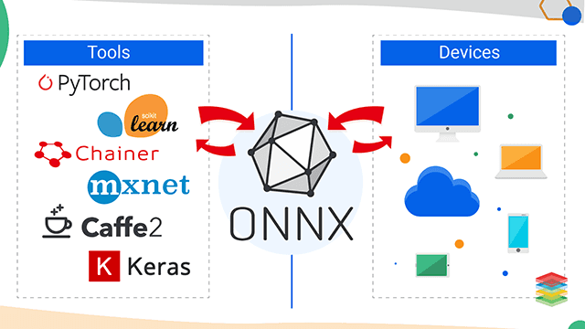
Language agnostic exchange formats
There are a lot of different frameworks to train models, runtimes to execute models, compilers to improve runtime of inferences, and other tooling.
Concerning inference runtime deployment there two choices:
either you deploy the inference runtimes for all the frameworks you want to use right now and foresee the need to extend your overall runtime with additional frameworks
use an interoperability standard like ONNX to serialize the trained model in a way that it may be executed by whatever interoperability standard runtime and every runtime implementation you might think of.
https://onnx.ai/

Slide 80
Orchestration Tools

Slide 81
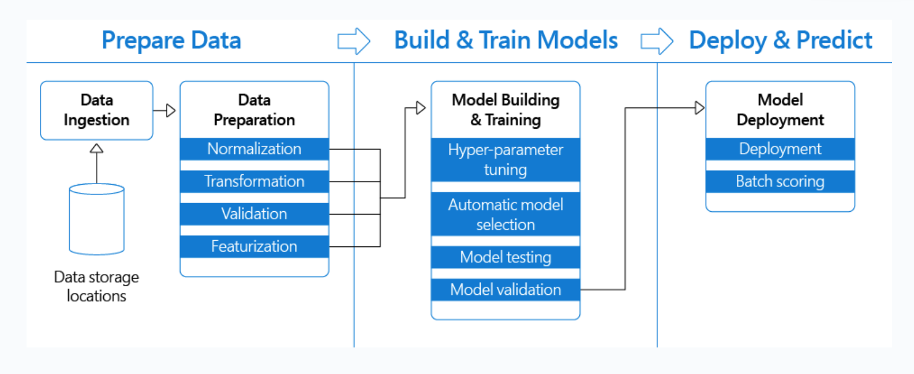
Orchestration Tools

Slide 82
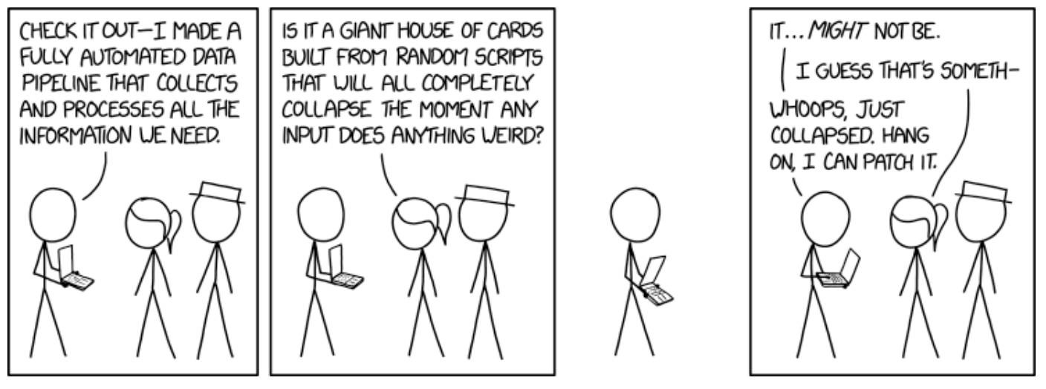
Orchestration Tools

Slide 83
Orchestration Tools
Implementing machine learning projects (and creating ML-based products) is at least as complex as any other software development.
For instance, in real-world ML projects, you must be able to:
Ingest the data in multiple formats
Pre-treat the data, clean the datasets, etc.
Do feature engineering
Train your models
Test them
Deploy your model
Implement CI/CD
Track your code using git
Track your models’ metrics
It is not possible to do using notebooks (if someone says otherwise, they are probably misleading you).
Code must be maintainable, scalable, trackable, and feasible to work in a more-than-one-person team.
Orchestration tools (e.g., Kedro, MetaFlow, ZenML, mlflow) are needed to develop industry-grade pipelines

Slide 84
Kedro Pipelines
https://kedro.org/
https://github.com/kedro-org/kedro-viz
See code/

Slide 85
ZenML Pipelines
https://zenml.io/home
See code/

Slide 86
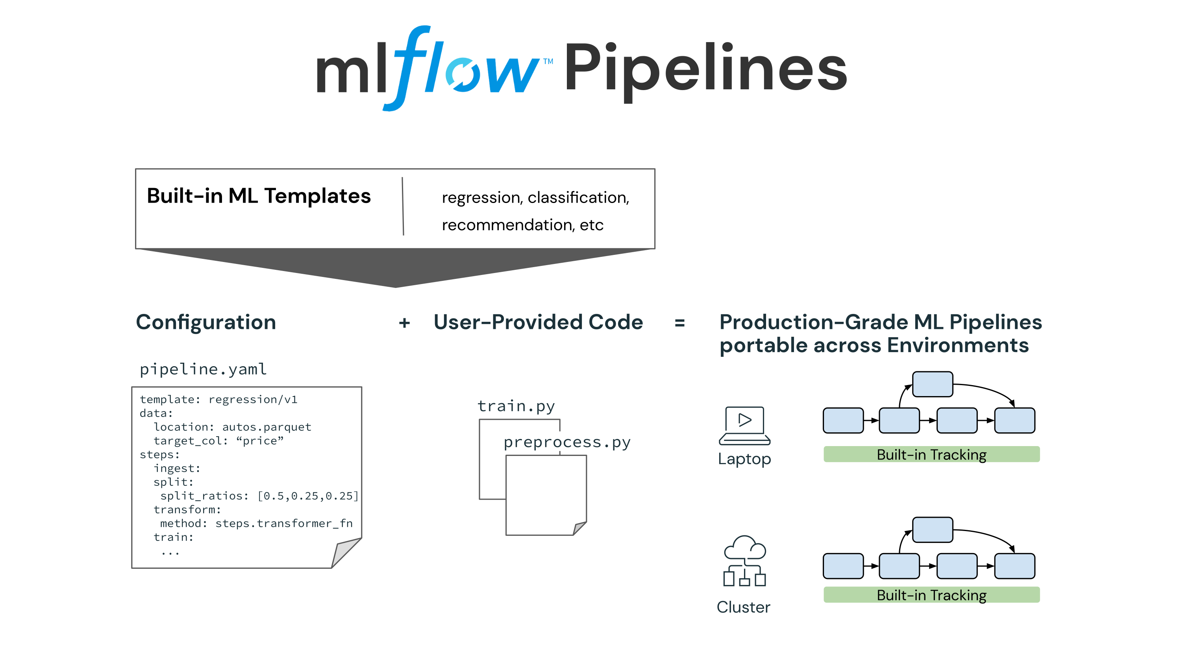
mlflow Pipelines

Slide 87
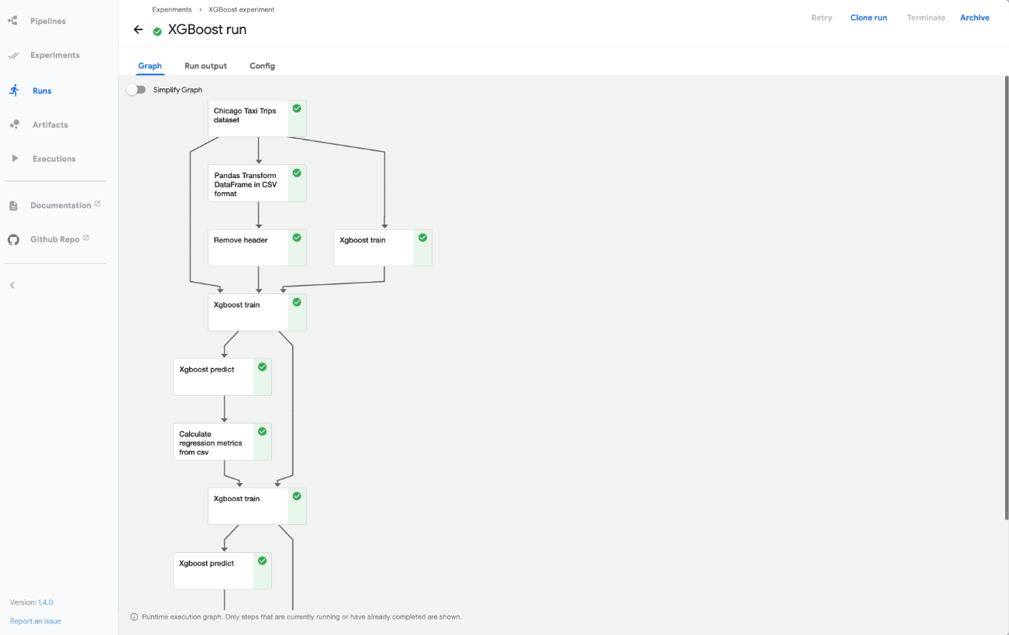
Kubeflow Pipelines

Slide 88
Experiment Tracking
https://neptune.ai/experiment-tracking

Slide 89
Feature Engineering Issues
Dynamic nature of feature definitions: A particular feature might end up having different definitions across multiple teams within the organization. If not properly documented, it gets increasingly difficult to maintain the logic behind the feature and the information conveyed by it.
Redundancy of features: When data has to be sourced in raw form, data scientists spend a lot of time re-extracting features that might have been already extracted by others in the team or by pipelines currently using the data.
Gap between experimentation and production environments: Products often use a handful of programming languages and frameworks, which could be different from the tools used to experiment with a machine learning model (e.g. data pipelines). This gap can cause inconsistencies that may get overlooked, and ultimately worsen the model/product on the customer’s end. In other words, the expected behavior/performance of the model in development should more or less be reproducible when deployed in the product.

Slide 90
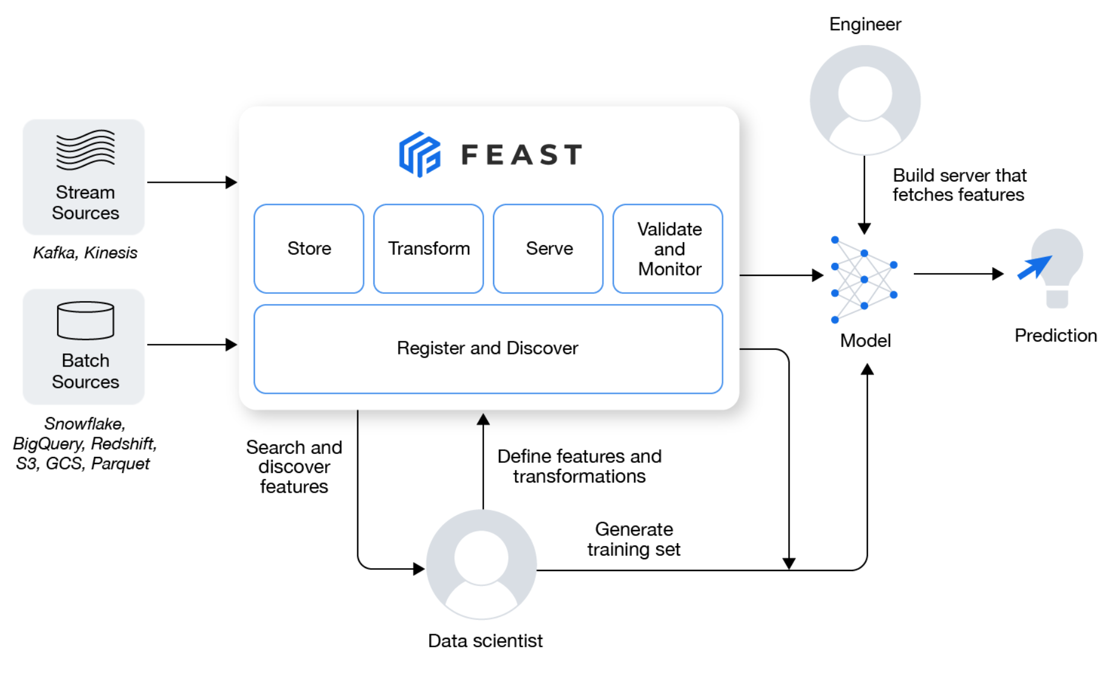
Feature Store
A Feature Store is a service that ingests large volumes of data, computes features, and stores them. With a Feature Store, machine learning pipelines and online applications have easy access to data.
Implemented as a dual-database, Feature Stores are designed to serve data both in real-time and to be processed in batches:
Online feature stores serve online applications with data at a low-latency. Examples include MySQL Cluster, Redis, Cassandra DB, etc.
Offline feature stores are scale-out SQL databases that provide data for developing AI models and make feature governance possible for explainability and transparency. Examples include Hive, BigQuery, Parquet.
Benefits of a Feature Store in ML pipelines
The output from Feature Stores is implementation-agnostic. No matter which algorithm or framework we use, the application/model will get data in a consistent format.
Another major benefit of using a Feature Store is saving time that would otherwise be spent computing features.

Slide 91
Components of a Feature Store
Feature Registry: Feature Registry provides a central interface that can be used by data consumers to maintain a list of features along with their definitions and metadata.
Transform: data transformation pipelines absorb raw data and transform it into usable features. Feature Stores are responsible for managing and orchestrating them. There are three main types of transformations:
Stream for data with velocity (for example real-time logs),
Batch for stationary data,
On-demand for data that cannot be pre-computed.
Storage: Features that are not immediately required are offline, and usually stored in warehouses such as Snowflake, Hive, or Redshift. On the other hand, online features are required in real-time and stored in databases such as MongoDB, CassandraDB, or Elasticsearch, with low-latency capabilities.
Serving: The logic behind feature extraction and processing is abstracted, which makes Feature Stores very attractive. While data scientists access the snapshot of data (point-in-time) for experimentation purposes, Feature Stores ensure that these features are constantly updated in real-time, and readily available to the applications that need them.
Operational Monitoring: Machine learning models may perform well during initial stages, but you must still monitor them for correctness and reliable results over time. There’s always the possibility of a degrading relationship between the independent and dependent variables in a machine learning model.

Slide 92
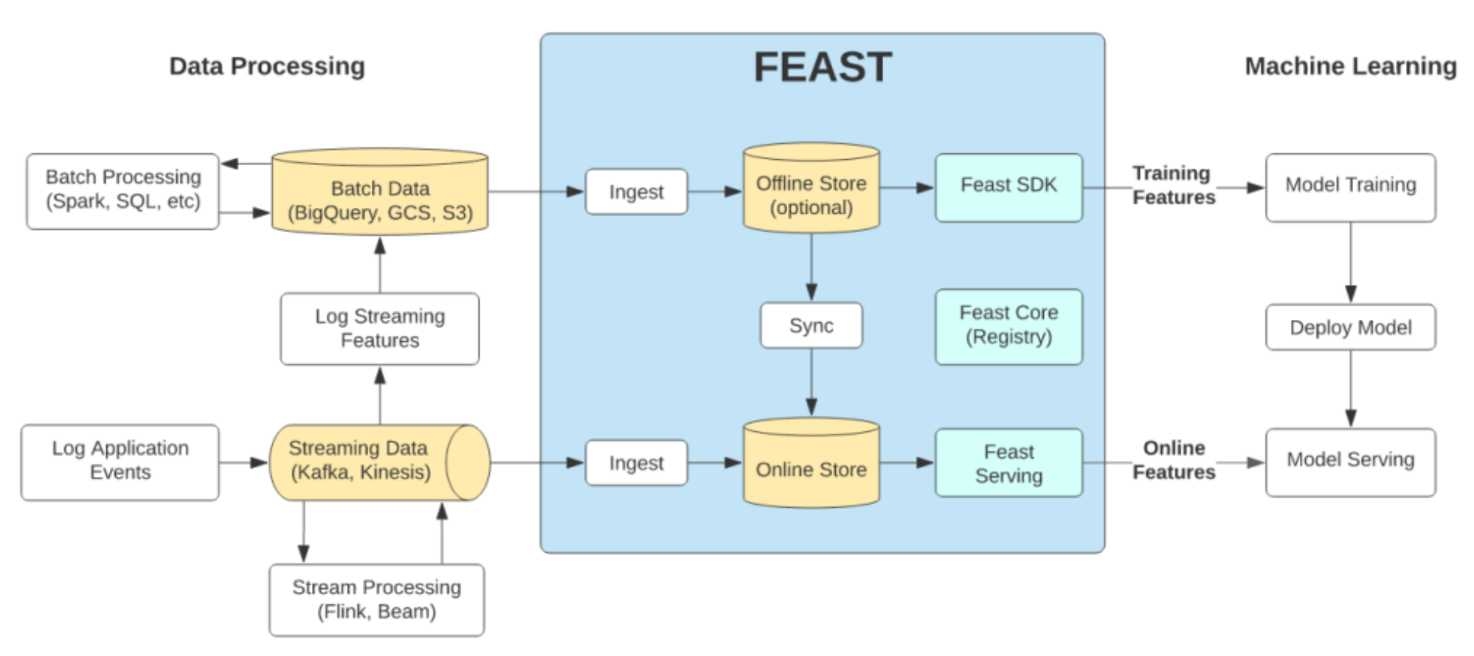
Google Feast

Slide 93
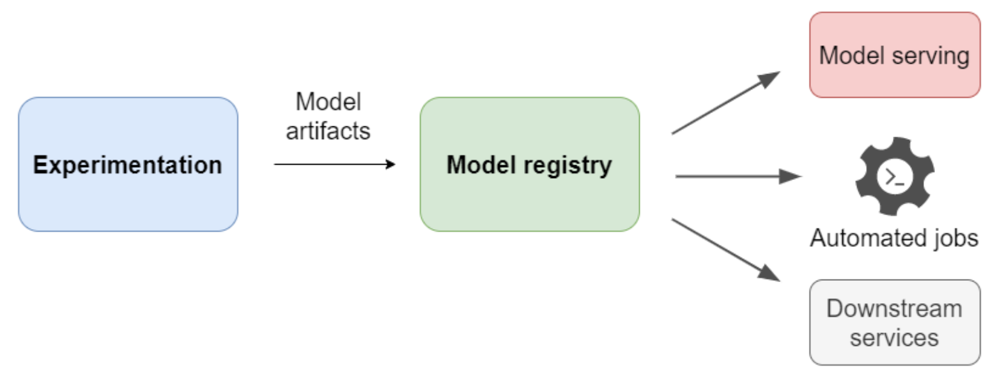
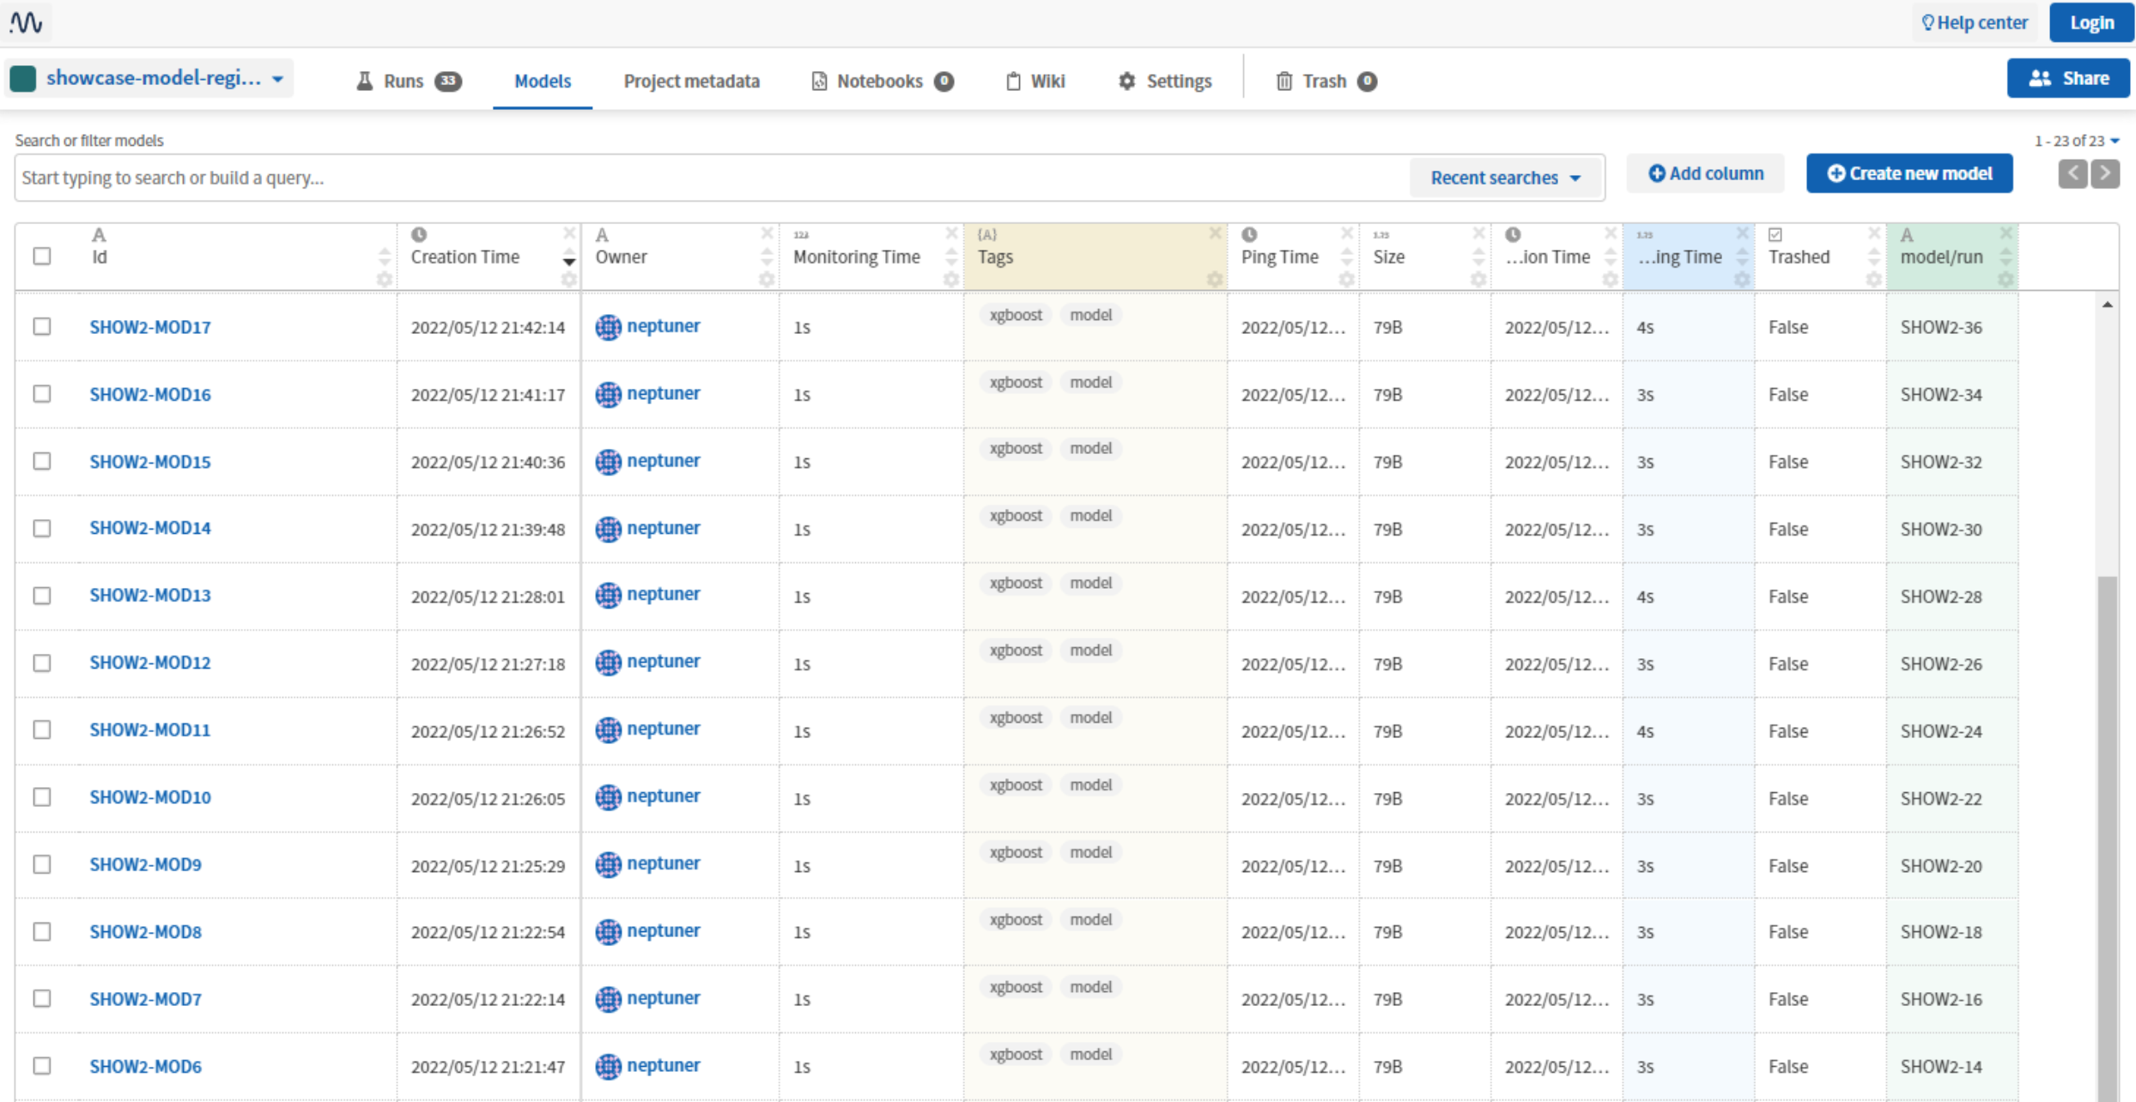
Model Registry
A model registry is a central repository that allows model developers to publish production-ready models for ease of access.
With the registry, developers can work together with other teams and stakeholders, collaboratively manage the lifecycle of all models in the organization.
Search for models
View the status of models (if they are being staged, deployed, or retired)
Approve or disapprove models across different stages
And view the necessary documentation
Look up the validation results and other metrics
Package the model (if needed)
And move it from the staging environment to the production environment

Slide 94
Model Registry
Monitoring
Track and store online and offline evaluation metrics for the models. With this functionality, you can easily look up models that are in production to detect a drop in the performance of the model (or concept drift).
Track the system metrics to understand which models are consuming the most application resources (CPU, memory, and GPU usage).
Production model governance
Enforce the documentation and reporting of models, ensuring results are repeatable and can be reproduced by any auditing user.
Review, approve, release, and rollback are all steps in the model launch process that the registry may help with. These choices are based on a variety of factors, including offline performance, bias and fairness measures, and the results of online experiments.
Security
Models, as well as the underlying packages used to build them, must be scanned for vulnerabilities, especially when a large number of packages are used to develop and deploy the models. The model registry can manage specific versions of the packages and you can scan and remove security vulnerabilities that may pose a threat to the system.
Models are likewise vulnerable to adversarial attacks, and as a result, they must be maintained and secured. In some cases, the least privilege access security concept must be employed so that only authorized users have access to specified model information, data privacy, and protecting PII and other resources.
https://www.youtube.com/watch?v=P_Ql-cPaBBs

Slide 95
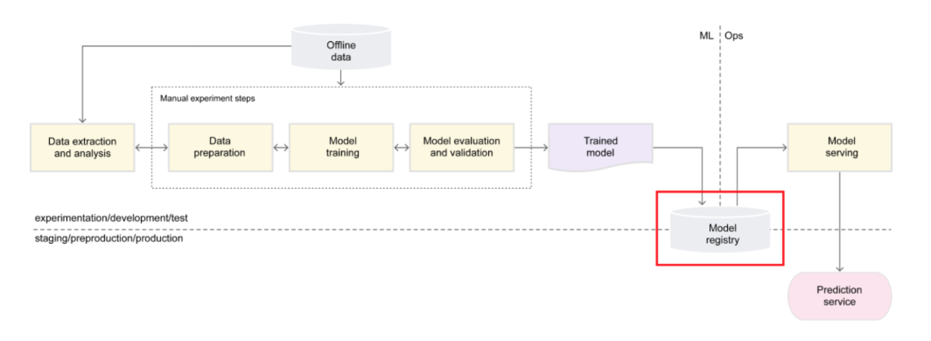
MLOps stack – Level 0

Slide 96
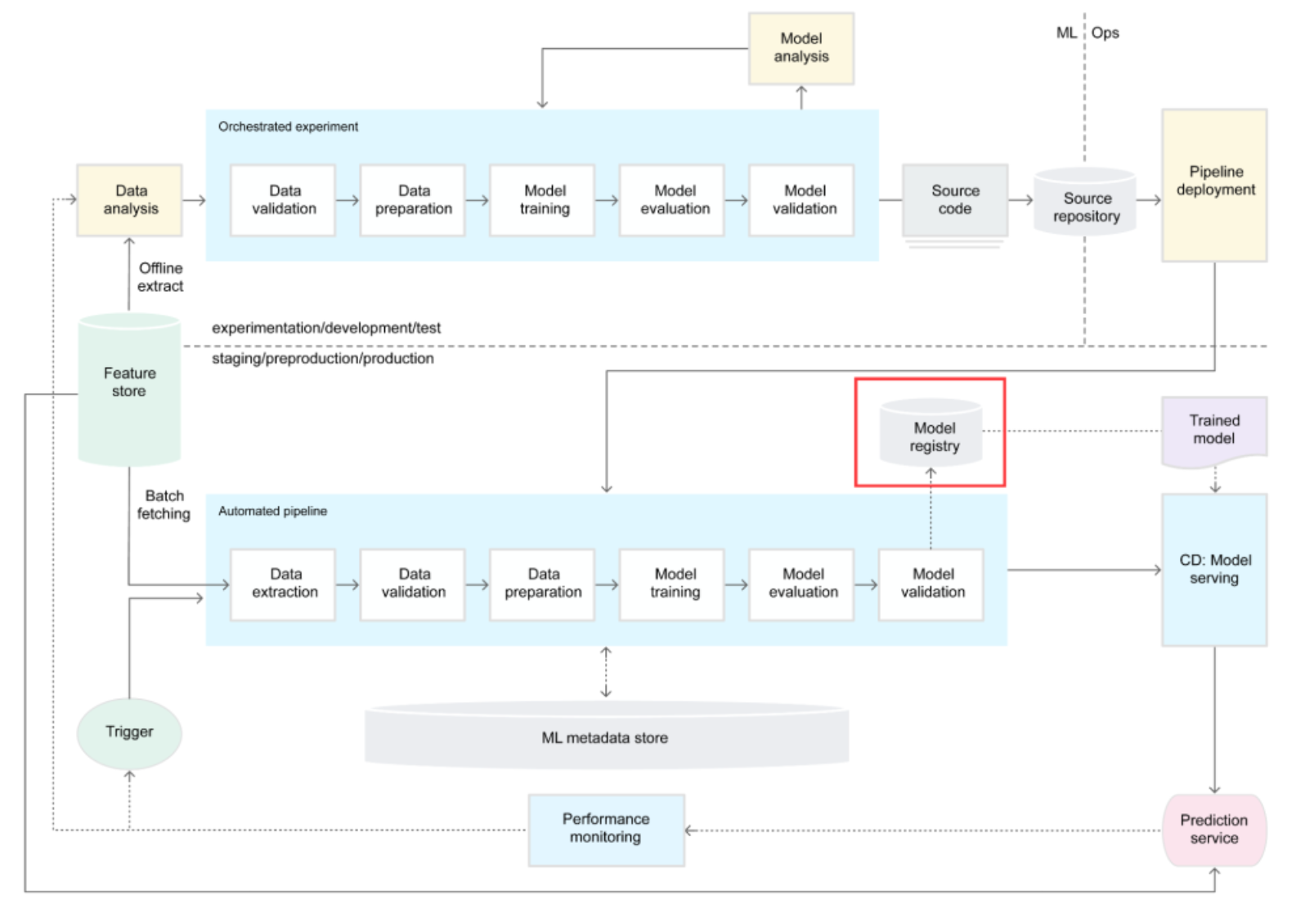
MLOps stack – Level 1

Slide 97
Model Operationalization

Slide 98
Model Operationalization
Once we trained a machine learning model, we need to deploy it as part of a business application such as a mobile or desktop application.
The final stage of the ML workflow is the integration of the previously engineered ML model into existing software. This stage includes the following operations:
Model Serving - The process of addressing the ML model artifact in a production environment.
Model Performance Monitoring - The process of observing the ML model performance based on live and previously unseen data, such as prediction or recommendation. In particular, we are interested in ML-specific signals, such as prediction deviation from previous model performance. These signals might be used as triggers for model re-training.
Model Performance Logging - Every inference request results in the log-record.

Slide 99
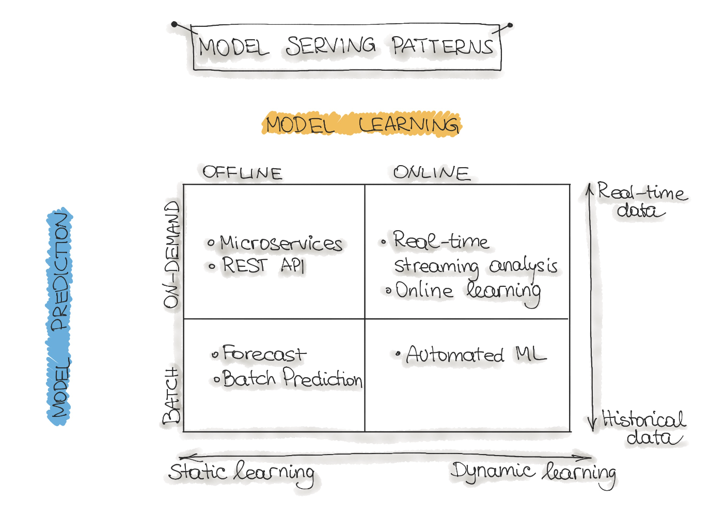
Different forms of ML workflows
Operating an ML model might assume several architectural styles. In the following, we discuss four architectural patterns which are classified along two dimensions:
ML Model Learning
ML Model Prediction

Slide 100
Different forms of ML workflows
Model Training:
Offline learning (aka batch or static learning): The model is trained on a set of already collected data. After deploying to the production environment, the ML model remains constant until it re-trained because the model will see a lot of real-live data and becomes stale. This phenomenon is called ‘model decay’ and should be carefully monitored.
Online learning (aka dynamic learning): The model is regularly being re-trained as new data arrives, e.g. as data streams. This is usually the case for ML systems that use time-series data, such as sensor, or stock trading data to accommodate the temporal effects in the ML model.
Model Prediction:
Batch predictions: The deployed ML model makes a set of predictions based on historical input data. This is often sufficient for data that is not time-dependent, or when it is not critical to obtain real-time predictions as output.
Real-time predictions (aka on-demand predictions): Predictions are generated in real-time using the input data that is available at the time of the request.

Slide 101
Model Serving Patterns - Forecast
This type of machine learning workflow is widely spread in academic research or data science education (e.g., Kaggle or DataCamp). This form is used to experiment with ML algorithms and data as it is the easiest way to create a machine learning system.
Usually, we take an available dataset, train the ML model, then run this model on another (mostly historical) data, and the ML model makes predictions. This way, we output a forecast. This ML workflow is not very useful and, therefore, not common in an industry setting for production systems (e.g. mobile applications).

Slide 102
Model Serving Patterns - Webservice
The most commonly described deployment architecture for ML models is a web service (microservice). The web service takes input data and outputs a prediction for the input data points. The model is trained offline on historical data, but it uses real-live data to make predictions.
The difference from a forecast (batch predictions) is that the ML model runs near real-time and handles a single record at a time instead of processing all the data at once. The web service uses real-time data to make predictions, but the model remains constant until it is re-trained and re-deployed into the production system.

Slide 103
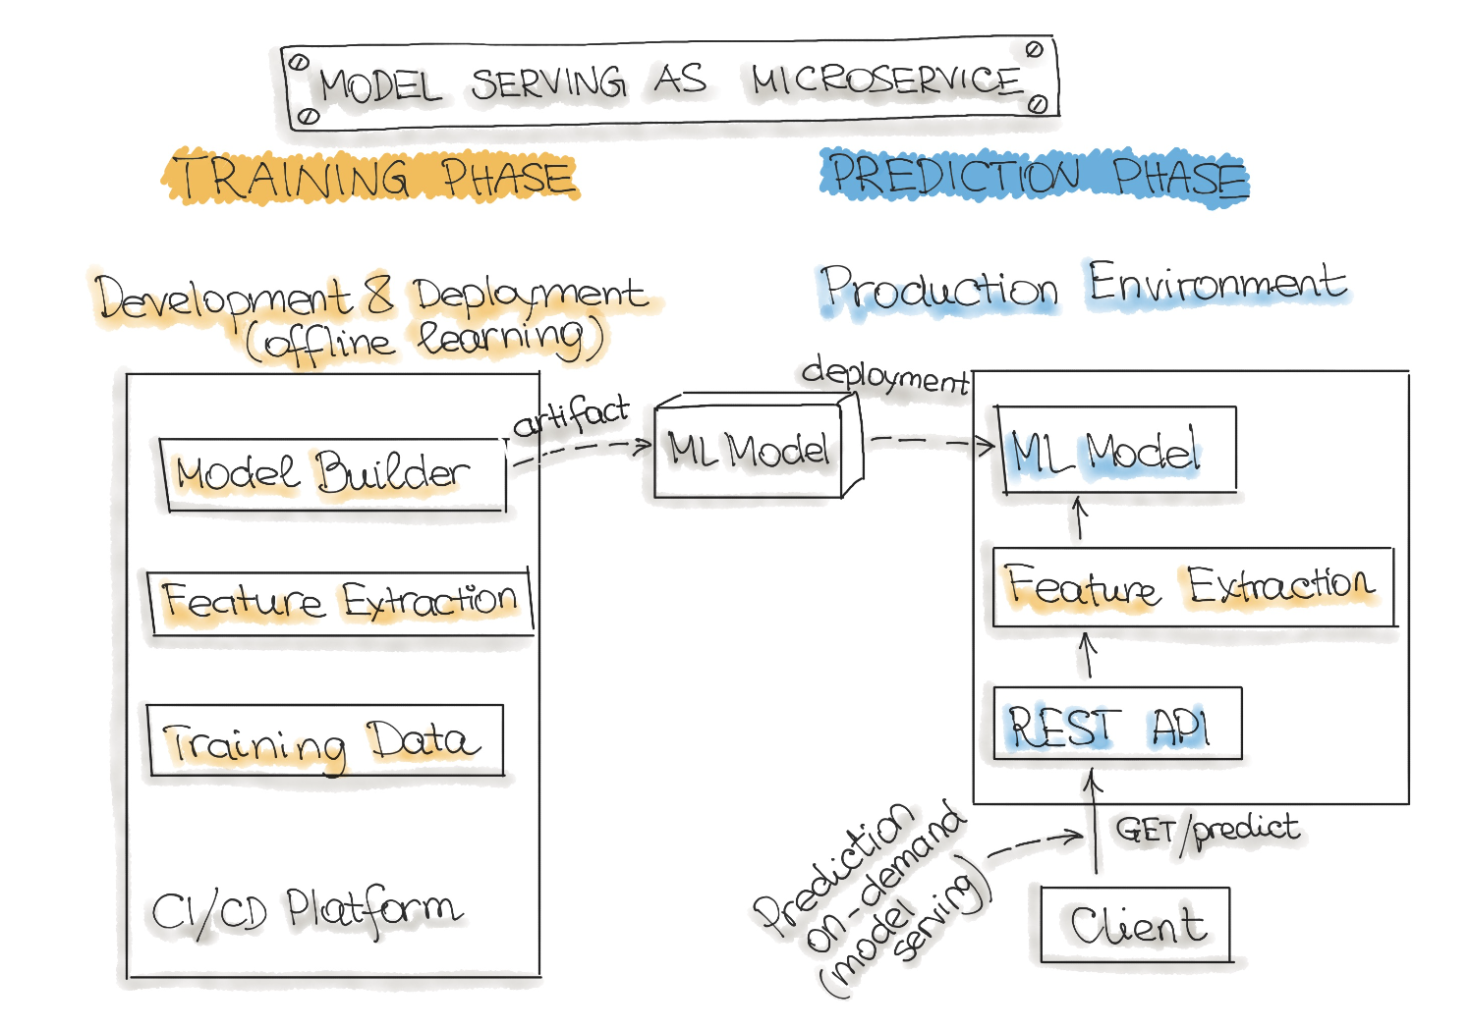
Model Serving Patterns - Webservice

Slide 104
Model Serving Patterns - Online learning
The most dynamic way to embed machine learning into a production system is to implement online learning, which is also known as real-time streaming analytics.
In this type of ML workflow, the ML learning algorithm is continuously receiving a data stream, either as single data points or in small groups called mini-batches. The system learns about new data on the fly as it arrives, so the ML model is incrementally being re-trained with new data. This continually re-trained model is instantly available as a web service.
Technically, this type of ML system works well with the lambda architecture in big data systems. Usually, the input data is a stream of events, and the ML model takes the data as it enters the system, provides predictions and re-learns on these new data. The model would typically run as a service on a Kubernetes cluster or similar.
A big difficulty with the online learning system in production is that if bad data is entering the system, the ML model, as well as the whole system performance, will increasingly decline.

Slide 105
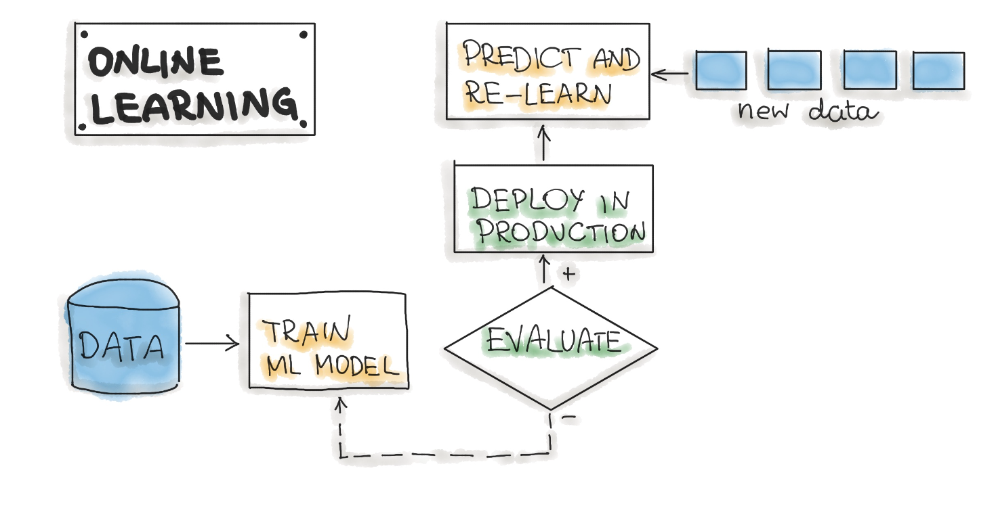
Model Serving Patterns - Online learning

Slide 106
Model Serving Patterns - AutoML
An even more sophisticated version of online learning is automated machine learning or AutoML.
AutoML is getting a lot of attention and is considered the next advance for enterprise ML. AutoML promises training ML models with minimal effort and without machine learning expertise. The user needs to provide data, and the AutoML system automatically selects an ML algorithm, such as neural network architecture, and configures the selected algorithm.
Instead of updating the model, we execute an entire ML model training pipeline in production that results in new models on the fly. For now, this is a very experimental way to implement ML workflows. AutoML is usually provided by big cloud providers, such as Google or MS Azure. However, models build with AutoML need to reach the level of accuracy required for real-world success.

Slide 107
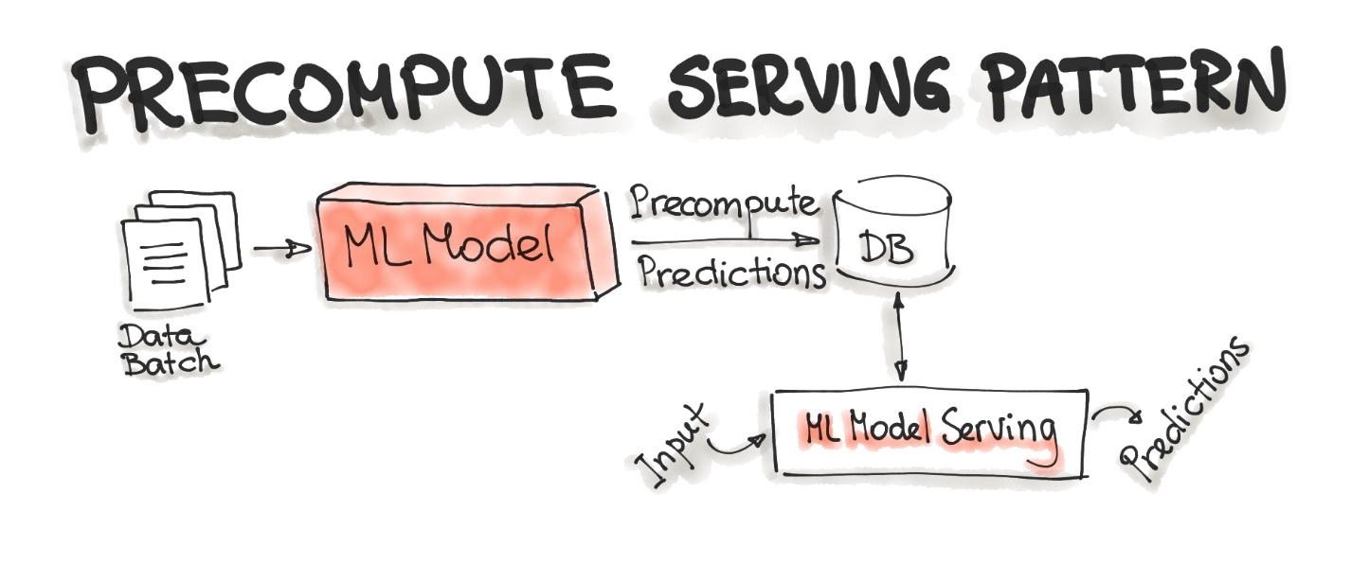
Model Integration
With the Precompute serving pattern, we use an already trained ML model and precompute the predictions for the incoming batch of data. The resulting predictions are persisted in the database. Therefore, for any input request, we query the database to get the prediction result.
This type of ML model serving is tightly related to the Forecast ML workflow.

Slide 108

Model Integration
A packaged ML model is considered as a dependency within the software application (OOP approach).
For example, the application consumes the ML model like a conventional jar dependency by invoking the prediction method and passing the values. The return value of such method execution is some prediction that is performed by the previously trained ML model.
The Model-as-Dependency approach is mostly used for implementing the Forecast pattern.

Slide 109

Model Integration
Model-as-Service is a common pattern for wrapping an ML model as an independent service. We can wrap the ML model and the interpreter within a dedicated web service that applications can request through a REST API or consume as a gRPC service (microservices approach).
This pattern can be used for various ML workflows, such as Forecast, Web Service, Online Learning.
Can be containerized as a standalone service

Slide 110

Model Integration
Faster and more reliable alternative to stateless HTTP communications
The event processor contains the model serving runtime and the ML model. It connects to the broker, reads these requests in batch from the queue, sends them to the model to make the predictions, and writes the resulted predictions to the output queue.
Afterwards, the queued prediction results are pushed to the prediction service that initiated the prediction request.
Can be containerized as a standalone service

Slide 111

Model Integration
The big benefit of Federated Learning is that the data used for training and testing, which is highly personal, never leaves the devices while still capturing all data that is available. This way it is possible to train highly accurate models while not having to store tons of (probably personal) data in the cloud.
But there is no such thing as a free lunch, normal machine learning algorithms are built with homogeneously and large datasets on powerful hardware which is always available for training. With Federated Learning there are other circumstances, the mobile devices are less powerful, the training data is distributed across millions of devices and these are not always available for training.
Exactly for this TensorFlow Federated (TFF) has been created. TFF is a lightweight form of TensorFlow created for Federated Learning.

Slide 112
Model Serving Frameworks
https://docs.bentoml.org/en/latest/tutorial.html

Slide 113
Observability
If we wait until an incident occurs to collect debugging data, we will need to wait until it occurs again, severely increasing MTTR (Mean Time To Repair).
Observability goes beyond monitoring by combining metrics, events, logs, and traces to help detect, investigate, and resolve unknown unknowns.
The goal is to understand the current state of the system, and how that state was reached (traceability, accountability). The term system here includes all our application and infrastructure components across the different layers (see also here).
Key components
Application\Infrastructure Monitoring
Model Monitoring

Slide 114

Application/Infrastructure Monitoring
DevOps observability solutions are useful in MLOps as well:
how much RAM and CPU it is consuming ?
how fast predictions are being computed ?
how long a client must wait for a prediction ?
which service affects the latency the most ?

Slide 115
Model Monitoring
On the other hand, the company might discover that even though some customers report being unhappy, none of their traditional observability tools seem to show any incidents or anything out of order.
The model-serving instances are running without any problems, and input data is being processed without errors.
This is where observability for MLOps comes in, which addresses several challenges not commonly encountered in non-ML systems.
A front-end engineer might change one of the data input fields from "required" to "optional," and customers stop filling in the field, leading to an increase in "missing values," which get substituted using default values.
A company might decide to change the height representation from ”feet" to "centimeters" but not re-train the model or update the data transformation stage within their data pipeline. The meaning of an input value of "100" drastically changed, but the model will likely continue to make predictions without errors.
Even though a model might work well when only considering accuracy, we won't be happy with it if it is biased against some group of customers. If it turns out that although our model works well in general with >90% accuracy but always gives the wrong prediction for “pregnant women”, the model will be unacceptable. Fairness in artificial intelligence is an active research topic.

Slide 116

Model Monitoring

Slide 117

Model Monitoring

Slide 118


Model Monitoring

Slide 119
Model Monitoring
An model monitoring solution should collect data (metrics, events, logs, and traces) from all steps within the ML lifecycle and deliver actionable insights to the right people.
It should monitor data distributions throughout all stages in a variety of forms. Distributions of individual features, joint distributions of features, and conditional distributions (e.g., split by target variable) can all provide different insights into data quality. The solution should also be able to detect missing values and schema changes.
Visualizations should be specific to the situation, interactive, and easily adaptable; for example, by showing feature distributions conditioned on a target variable chosen by the user, before and after the data transformation step — and how they changed over time.
We can define (and iterate on) input data schemas; for example, human adults should be between 30 and 300 centimeters tall and alert relevant people if those schemas are violated. Similarly, we can monitor the output data and alert on things such as a predicted probability not being between 0 and 1 or a model starting to predict one possible value much more often than alternative values.
Model explainability can be leveraged to gain insight into why a model made a certain prediction. For example, LIME or SHAP values can be used to analyze the relationship between input features and model predictions. This can help us understand if a model is underperforming or biased against a particular sub-group.

Slide 120

Training-serving skew
It is often mixed with data drift or used interchangeably but the root cause of skew is not the same.
In this case, there is no "drift," which assumes a change during the production use of the model.
Training-serving skew often happens when you train a model on an artificially constructed or cleaned dataset. This data does not necessarily represent the real world, or does this incompletely.

Slide 121

“Past performance is no guarantee of future results”
People call it model drift, decay, or staleness.
Things change, and model performance degrades over time.
The ultimate measure is the model quality metric. It can be accuracy, mean error rate, or some downstream business KPI, such as click-through rate.
No model lives forever, but the speed of decay varies.
Some models can last years without an update. For example, certain computer vision or language models. Or any decision system in an isolated, stable environment.
Others might need daily retraining on the fresh data.

Slide 122

Data Drift
Data drift, feature drift, population, or covariate shift. Quite a few names to describe essentially the same thing. Which is: the input data has changed.
The distribution of the variables is meaningfully different. As a result, the trained model is not relevant for this new data.
It would still perform well on the data that is similar to the "old" one! The model is fine, as much as the model "in a vacuum" can be.
In practical terms, it become dramatically less useful since we are dealing with a new feature space.

Slide 123

Data Drift
Data drift, feature drift, population, or covariate shift. Quite a few names to describe essentially the same thing. Which is: the input data has changed.
The distribution of the variables is meaningfully different. As a result, the trained model is not relevant for this new data.
It would still perform well on the data that is similar to the "old" one! The model is fine, as much as the model "in a vacuum" can be.
In practical terms, it become dramatically less useful since we are dealing with a new feature space.

Slide 124
Concept Drift
Concept drift occurs when the patterns the model learned no longer hold.
In contrast to the data drift, the distributions (such as user demographics, frequency of words, etc.) might even remain the same. Instead, the relationships between the model inputs and outputs change.
In essence, the very meaning of what we are trying to predict evolves. Depending on the scale, this will make the model less accurate or even obsolete.
How fast do models age?
It depends, of course. But it is often possible to get an estimate ahead of time.
If we are building a supervised prediction model, we know the past ground truth. We can train the model on older data and apply it to later periods. Then we can imitate model retraining with different frequencies and measure how it impacts model quality.
Such a test gives us a good proxy on regular model retraining needs. Does each new week's data improve the performance? Or a 3-month old model still performs as good as new?

Slide 125

Gradual Concept Drift
Gradual or incremental drift is the one we expect. The world changes and the model grows old. Its quality decline follows the gradual changes in external factors. Some examples:
Competitors launch new products. Consumers have more choices, and their behavior changes. As should sales forecasting models.
Macroeconomic conditions evolve. As some borrowers default on their loans, the credit risk is redefined. Scoring models need to learn it.
Mechanical wear of equipment. Under the same process parameters, the patterns are now slightly different. It affects quality prediction models in manufacturing.

Slide 126

Sudden Concept Drift
External changes might be more sudden or drastic (e.g. COVID). Almost overnight, the mobility and shopping patterns shifted. Demand forecasting models would not guess that sales of yoga pants surge 350% (like it happened to Stitch Fix) or that most flights will be canceled as borders close.
Some examples:
Change in the interest rate by the central bank. All financial and investment behavior is affected, and models fail to adapt to unseen patterns.
Technical revamp of the production line. Predictive maintenance becomes obsolete since modified equipment has new failure modes (or lack of those).
Major update in the app interface. Past data on clicks and conversion becomes irrelevant since the user journey is a new one.

Slide 127

Recurring Concept Drift
Seasonality is a known modeling concept. It indeed looks like (and it is) a temporary change in the target function.
The same people that shop modestly during the year show unusual patterns on Black Fridays. Bank holidays affect everything, from retail sales to production failures. Mobility on the weekend is different from business days. And so on.
From the point of model monitoring, this "drift" has no importance. Weekends happen every week, and we don't need an alert. Unless we see a new pattern, of course.

Slide 128
Keep an eye on model drift
Online measurement of accuracy: Just as you need to know the latency of your website and public application programming interfaces, you need to know how accurate your models are in production. How many predictions actually came true? This requires collecting and logging real-use results but is an elementary requirement.
Mind the gap: That is, watch out for gaps between the distributions of your training and online data sets. This is a simple-to-measure, effective-in-practice heuristic that uncovers a variety of issues. If your training data has 50% high-risk patients, but in production, you're predicting only 30% as high-risk, it's probably time to retrain.
Online data quality alerts: If the number or ratio of the input data changes in an unexpected way, an alert should go to your operations team. Are you patients suddenly older, more female or less diabetic? If you haven't trained your model on those types of patients, you may be serving bad predictions.

Slide 129

Keep an eye on model drift

Slide 130

Model rollout
A/B testing is an excellent strategy to validate whether a new model or a new version outperforms the current one. All this while testing with the actual users. The improvements can be in terms of F1 score, user engagement, or better response time.
Let’s consider the case when we want to test the model’s performance. To run A/B testing, we need to:
Define the hypothesis. In this step, we decide what is it we want to test. In our case, we want to test whether the new model version provides faster predictions.
Define metric(s). To pick the better version in the test, we need to have a metric to measure. In this example, we will measure the time spent from the user’s request arrival until it gets a response.
Create variant. Here we need to create a deployment that uses the new model version.
Run experiment. After preparing the variant, we can run the experiment, ideally for a defined time frame.
Collect data. At the same time, we must be collecting the data needed to measure the metric(s) from 2.
Analyze results. All that is left now is to analyze the data and pick the variant that yields better results.

Slide 131
MLOps level 0-1-2

Slide 132
MLOps level 0
An entirely manual ML workflow
Might be enough if models are rarely changed or trained
In practice, models often break when they are deployed in the real world. Models fail to adapt to changes in the dynamics of the environment or changes in the data that describes the environment
Why Machine Learning Models Crash and Burn in Production - Forbes
Manual, script-driven, and interactive process: every step is manual, including data analysis, data preparation, model training, and validation.
Disconnect between ML and operations: the process separates data scientists who create the model, and engineers who serve the model as a prediction service. The data scientists hand over a trained model as an artifact for the engineering team to deploy on their API infrastructure.
Infrequent release iterations: the assumption is that your data science team manages a few models that don’t change frequently—either changing model implementation or retraining the model with new data.
No Continuous Integration (CI): because few implementation changes are assumed, you ignore CI. Usually, testing the code is part of the notebooks or script execution.
No Continuous Deployment (CD): because there aren’t frequent model version deployments, CD isn’t considered.
Lack of active performance monitoring: the process doesn’t track or log model predictions and actions.

Slide 133
MLOps level 0

Slide 134
MLOps level 1
The goal of MLOps level 1 is to perform continuous training (CT) of the model by automating the ML pipeline. This way, you achieve continuous delivery of model prediction service.
This scenario may be helpful for solutions that operate in a constantly changing environment and need to proactively address shifts in customer behavior, price rates, and other indicators.
Rapid experiment: ML experiment steps are orchestrated and done automatically.
CT of the model in production: the model is automatically trained in production, using fresh data based on live pipeline triggers.
Experimental-operational symmetry: the pipeline implementation that’s used in the development or experiment environment is used in the preproduction and production environment, which is a key aspect of MLOps practice for unifying DevOps.
Modularized code for components and pipelines: to construct ML pipelines, components need to be reusable, composable, and potentially shareable across ML pipelines (i.e. using containers).
Continuous delivery of models: the model deployment step, which serves the trained and validated model as a prediction service for online predictions, is automated.
Pipeline deployment: in level 0, you deploy a trained model as a prediction service to production. For level 1, you deploy a whole training pipeline, which automatically and recurrently runs to serve the trained model as the prediction service.
Metadata management: information about each execution of the ML pipeline is recorded in order to help with data and artifacts lineage, reproducibility, and comparisons. It also helps you debug errors and anomalies

Slide 135
MLOps level 1

Slide 136
MLOps level 2
For a rapid and reliable update of pipelines in production, you need a robust automated CI/CD system.
This level fits tech-driven companies that have to retrain their models daily, if not hourly, update them in minutes, and redeploy on thousands of servers simultaneously.
This MLOps setup includes the following components:
Source control
Test and build services
Deployment services
Model registry
Feature store
ML metadata store
ML pipeline orchestrator.
Development and experimentation: you iteratively try out new ML algorithms and new modeling where the experiment steps are orchestrated. The output of this stage is the source code of the ML pipeline steps, which are then pushed to a source repository.
Pipeline continuous integration: you build source code and run various tests. The outputs of this stage are pipeline components (packages, executables, and artifacts) to be deployed in a later stage.
Pipeline continuous delivery: you deploy the artifacts produced by the CI stage to the target environment. The output of this stage is a deployed pipeline with the new implementation of the model.
Automated triggering: the pipeline is automatically executed in production based on a schedule or in response to a trigger. The output of this stage is a newly trained model that is pushed to the model registry.
Model continuous delivery: you serve the trained model as a prediction service for the predictions. The output of this stage is a deployed model prediction service.
Monitoring: you collect statistics on model performance based on live data. The output of this stage is a trigger to execute the pipeline or to execute a new experiment cycle.

Slide 137

MLOps level 2

Slide 138

Example of a complete system

Slide 139
Service Mesh

Slide 140
Service Mesh
Direct connections vs service mesh
Apache Kafka
Kubernetes
Envoy
Istio
Linkerd

Slide 141
Best practices for Machine Learning

Slide 142

Engineering best practices for ML
https://se-ml.github.io/practices/

Slide 143
Case Studies

Slide 144
Uber’s Michelangelo
https://neptune.ai/blog/feature-stores-components-of-a-data-science-factory-guide
https://se-ml.github.io/practices/

Slide 145
FBLearner
https://se-ml.github.io/practices/

Slide 146
Azure ML, AWS Sagemaker, Vertex AI
https://se-ml.github.io/practices/

Slide 147
References

Slide 148
MLOPS
https://ml-ops.org/
https://se-ml.github.io/
https://neptune.ai/blog/mlops
https://github.com/EthicalML/awesome-production-machine-learning
https://mlops.toys/

Slide 149
Tools (Data Management)
Versioning
https://dvc.org/
https://lakefs.io/
https://github.com/dolthub/dolt
https://qri.io/
Validation
https://deepchecks.com/
https://github.com/awslabs/deequ
https://github.com/Pylons/colander
https://github.com/pyeve/cerberus
https://github.com/schematics/schematics
Labelling
https://github.com/nlplab/brat
https://github.com/heartexlabs/labelImg
https://github.com/midas-research/audino
https://github.com/mdhmz1/Auto-Annotate
https://labelstud.io/
Wrangling
https://pandas.pydata.org/

Slide 150
Tools (Modeling)
Feature Engineering
https://github.com/cod3licious/autofeat
https://github.com/alteryx/featuretools
https://github.com/blue-yonder/tsfresh
Hyperparameter Optimization
https://github.com/optuna/optuna
https://github.com/google/vizier
https://github.com/autonomio/talos
http://hyperopt.github.io/hyperopt/
https://scikit-optimize.github.io/stable/
Experiment Tracking
https://github.com/guildai/guildai
https://github.com/VertaAI/modeldb
https://github.com/tensorflow/tensorboard
Feature Store
https://github.com/feast-dev/feast
https://www.tecton.ai/
https://www.hopsworks.ai/
https://github.com/quintoandar/butterfree

Slide 151
Tools (Operationalization)
Model Deployment / Serving
https://github.com/bentoml/BentoML
https://github.com/SeldonIO/seldon-core
https://github.com/tensorflow/serving
Model Monitoring
https://github.com/evidentlyai/evidently
https://github.com/prometheus/prometheus
https://github.com/grafana/grafana
https://github.com/apache/kafka

Slide 152
Tools (Orchestration)
Orchestration
https://kedro.org/
https://zenml.io/home
https://airflow.apache.org/
https://mlflow.org/
https://www.kubeflow.org/

